Slide 1


Policy School
September 2019

Slide 2

Policy School
September 2019
National Centre for Rural Health and Care

Slide 3

by:
Jan Sobieraj & Ivan Annibal
Deputy Chair and Director of Operations
Ivan.Annibal@roseregeneration.co.uk

Slide 4
Us
Established in 2017
CIC structure, 9 Directors, 4 Support Staff, Core membership >60 supporters
Mission building a movement to address inequalities in the provision of rural health and care

Slide 5
Us
Our Connections
Board: PHE, AHSNs, RSN, University of Lincoln, Northumbria NHS Healthcare Trust, WONCA, NHS Midlands
Members inc: 8 Universities, Royal College of GPS, Royal Soc Public Health, Parkinsons, Dispensing Doctors Association, Airedale NHS Foundation Trust, NHS Confed plus approaching 50 other trusts, CCGs and Councils

Slide 6
4 Themes
Workforce, Research, Insight, Technology
Actions: Parliamentary Inquiry, Workforce – UoB study, Cost Base – Nuffield, Technology – Innovation Exchange, Insight – PHE agenda
Action Research: community pharmacy, GP accreditation, dispensing surgeries
Rural Proofing: Just beginning new toolkit development with Rural England

Slide 7
Context
Summary
Urban bias in the stats
Heavily loaded with older people
Higher service delivery costs
Sparsity driving significant proportion of overall debt within the system
Significantly fewer staff per head of population
Adult Social Care funding model unsustainable over time
NHS “place blind” with limited understanding of rural as a concept and limited appetite for risk and innovation in rural areas – matched in part at least by public attitudes

Slide 8
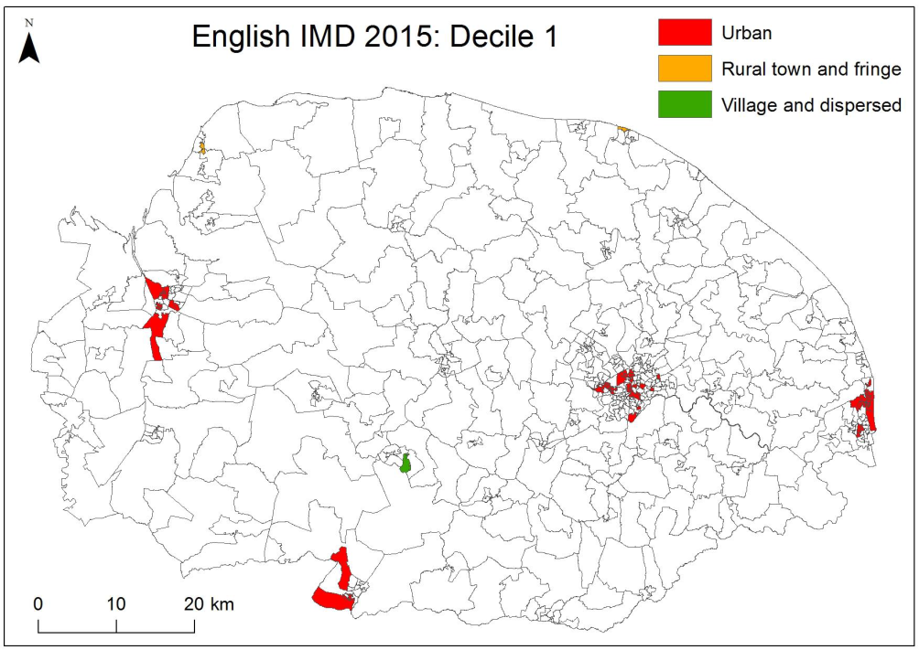
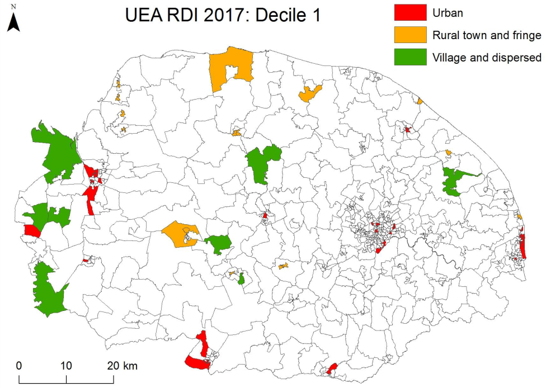
Context
Urban approach to analysis masks need
Norfolk example when dependence on Adult Social Care and enhanced distance from services are added
Mandy Burke and Andy Jones UEA

Slide 9
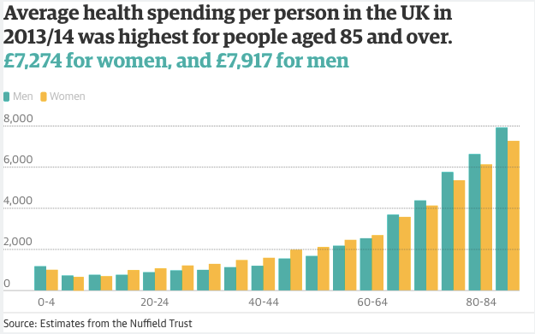
Context
Age is deceptive
Average life expectancy is highest in mainly rural areas (in 2013-15 it was 79.4 years for men and 83.1 years for women in England.)
It costs more to live in rural settings and to provide health care to them

Slide 10
Context
Recruitment is a challenge
Professional Group NHS staff per head ratio rural/urban
Overall 1.45
Professionally qualified clinical staff 1.48
HCHS Doctors 1.57
Consultant (including Directors of Public Health) 1.52
Associate Specialist 1.31
Specialty Doctor 1.42
Staff Grade 1.72
Specialty Registrar 1.87
Core Training 1.53
Foundation Doctor Year 2 1.45
Foundation Doctor Year 1 1.51
Hospital Practitioner / Clinical Assistant 0.87
Other and Local HCHS Doctor Grades 1.18
Nurses & health visitors 1.45
Midwives 1.60
Scientific, therapeutic & technical staff 1.48
Support to clinical staff 1.39
Support to doctors, nurses & midwives 1.41
Support to ST&T staff 1.34
NHS infrastructure support 1.42
Central functions 1.34
Hotel, property & estates 1.52
NHS Digital 2018
STP Area by Rural Population
1. Cornwall and Isles of Scilly (62%)
2. West, North and East Cumbria (54%)
3. Norfolk and Waveney (50%)
4. Lincolnshire (48%)
5. Somerset (48%)
6. Cambridgeshire and Peterborough (39%)
7. Shropshire, Telford and Wrekin (39%)
8. Suffolk and North East Essex (38%)
9. Durham, Darlington, Tees, Hambleton, Richmondshire and Whitby (35%)
10. Devon (34%)

Slide 11
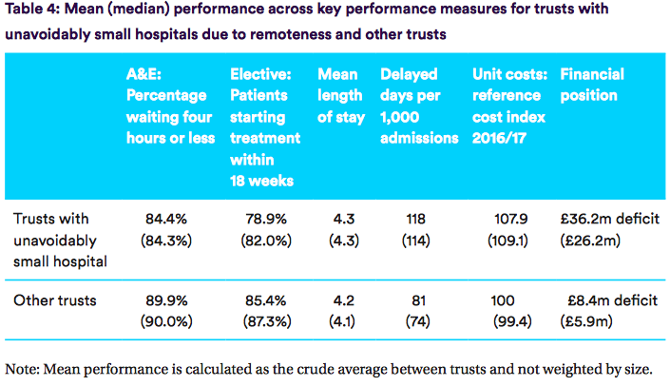
Unavoidably Small due to Remoteness
St Mary’s Hospital (Isle of Wight)
Cumberland Infirmary and West Cumberland Hospital (Cumbria)
Furness General Hospital (Cumbria)
Pilgrim Hospital Boston (Lincolnshire)
Hereford County Hospital (Herefordshire)
Scarborough General Hospital (North Yorkshire)
North Devon Hospital (Devon)
3% of trusts 23% total deficit
Nuffield Trust 2018
Context
Delivery is a challenge

Slide 12
Adult Social Care as a % of all budgets – NCRHC survey 2018 red line is % UK Pop over 65
Important to remember Adult Social Care
Despite extensive savings plans amounting to £43.079m, the use of reserves and one-off government funding the February 2018 financial strategy states the cumulative funding gap as at the end of each financial year is as follows: 2020/2021 = £187,984; 2021/2022 = £22,193,799, 2022/2023 = £25,848,518 County Council Survey Respondent

Slide 13
Context
Growing recognition of additional costs
“As part of [their] forward work programme [they] remain open to considering whether further adjustments are needed for services in rural, remote or sparse areas. In particular, [they] will consider if an additional adjustment for the travelling time of staff providing home services in sparsely populated areas is material.”
Note on Clinical Commissioning Group (CCG) Allocations 2019/20-2023/24 (ACRA)

Slide 14
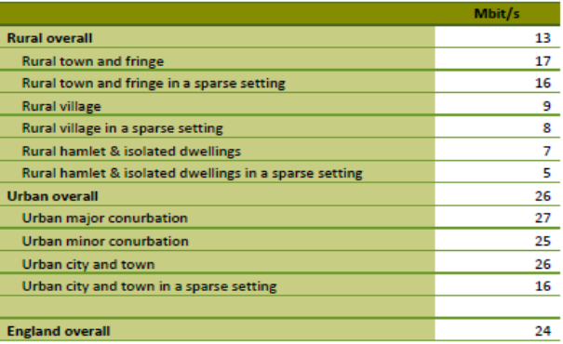
Other rural factors
Slower Broadband inhibits Technical Solutions
80% of rural residents live within 4km of a GP surgery, compared with 98% of the urban population.
Only 55%of rural households compared to 97% of urban households are within 8km of a hospital.
Rural house prices are 26% higher than in urban areas and are on average less affordable
Around 50% homes in the most rural areas and villages are classified as ‘non-decent’ compared to around 30% in small towns and urban areas.
Around 50% houses in the most rural areas and 25% in village centres are ‘energy inefficient’ compared with 7% in urban areas.
2 in 5 homes in rural areas are off the gas grid and have to rely on expensive fuel options

Slide 15
What do we want?
A rural lens within the NHS in relation to policy and funding
More appetite for risk and innovation in relation to service delivery strategies
A serious recognition of the role of communities in addressing the issues in the context of prevention
A more engaged approach to the application of technology – taking account of connectivity challenges
More accessible data to interpret the impact of rurality on health and care
These “asks” will deliver better outcomes and lower costs

Slide 16

Thank you.
Questions?

