Slide 1
Rural Services Conference Rural Health Challenges
Professor Richard Parish
National Centre for Rural Health and Care
September 2019

Slide 3
What am I going to cover?
Context and influences on health
Impact of recent changes in rural life
Select Committee on the Rural Economy
What we need to do to improve rural health and care

Slide 4
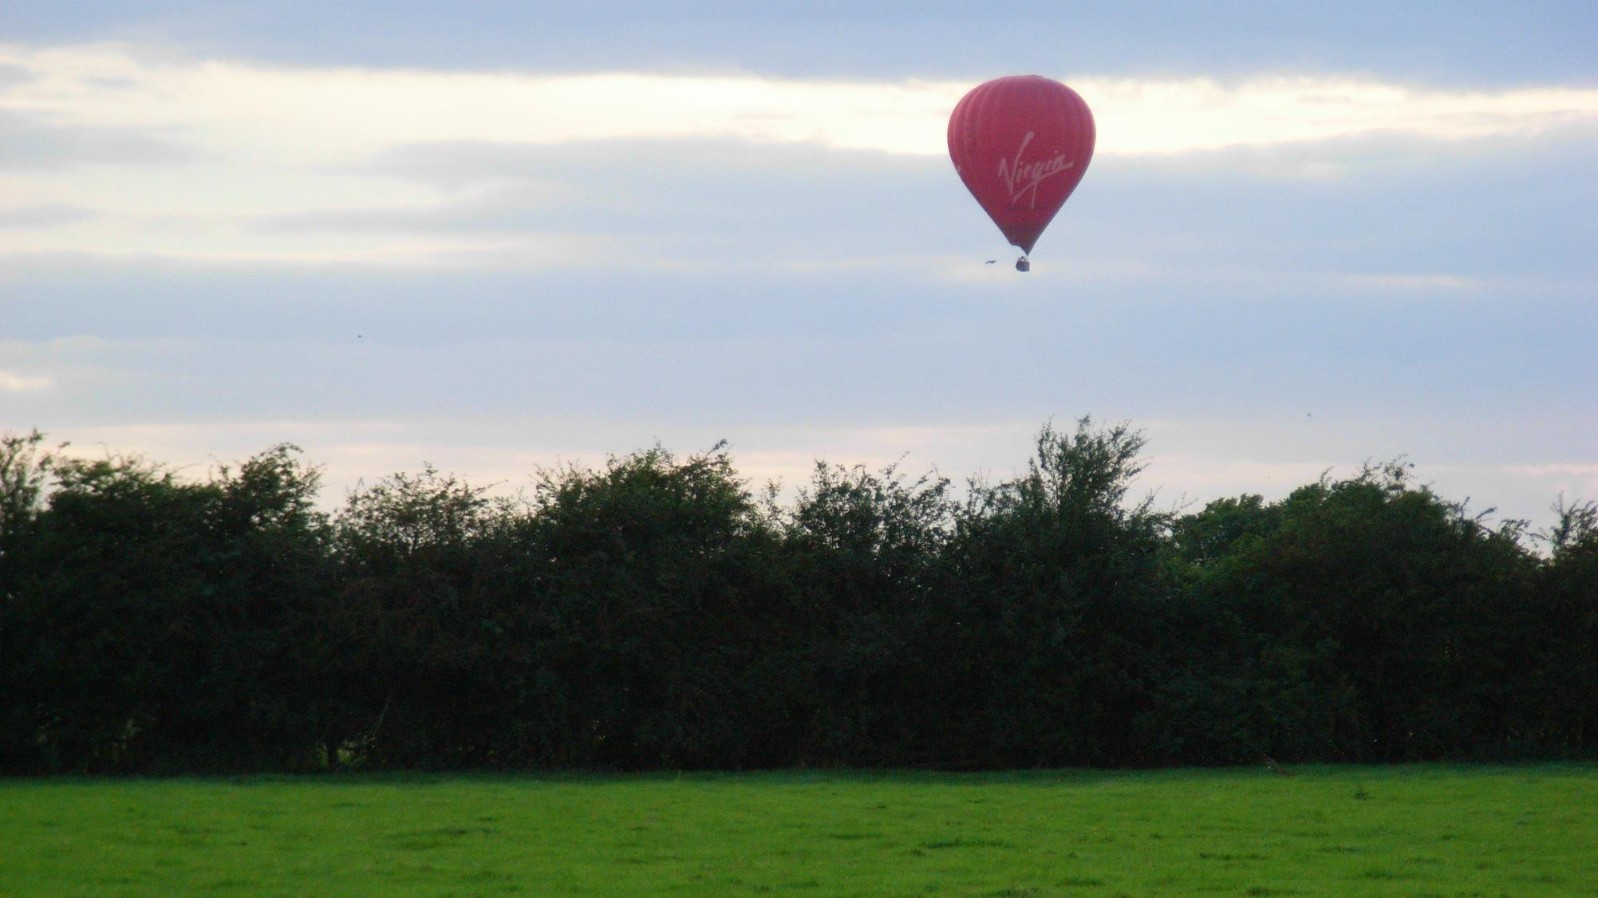
THE POSITIVES THE NEGATIVES
Space and relative tranquillity Social isolation and loneliness
Air quality and vehicle pollution Access to schools, hospitals, care centres, facilities
Self-sufficiency and local food production More costly food in shops
Volunteering Poorer access to job opportunities and training
Lower crime rates Service reduction
Higher life expectancy Seasonal employment
Lower infant mortality Weather in Winter

Slide 6
BUT, behind the positive aspects of rural life
Trend has been a reduction in:
Rural buses
Rural banks
Rural post offices
Rural pharmacies
Rural public services
Fewer churches
Farmer’s
wife
Three Blind Mice

Slide 7
Post Offices
Over 9,000 rural post offices in 2,000 to just over 6,000 in 2015.
However, 98.7% of residents still live within 3 miles of a post office in 2015

Slide 8
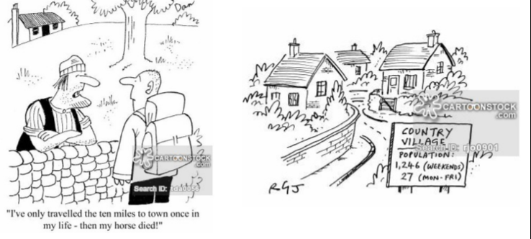

Slide 9
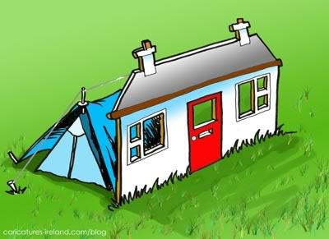
House Price Affordability
10 times average earnings in rural areas
Up to 14.6 times in some rural counties
National average is 8.2 times average earnings

Slide 10
Job Centres
40% of rural households are within 5 miles of a Job Centre compared to 95% of urban households

Slide 11
Access to Further Education
49% rural have ‘reasonable access’ compared to 69% urban
Choice of 2 intuitions compared to 4
£18 pw on travel compared to £15 (20% premium for rural learners)
90 minutes a day travel compared to 40 minutes
Apprenticeships – fewer large employers
ALL young people are supposed to be in education, training or apprenticeship until age 18

Slide 12
The population aged 65 years and over is projected to grow by around 50% in both urban and rural areas between 2016 and 2039.
In comparison, the younger population (aged under 65 years) is only projected to grow by 8% in urban areas, with virtually no increase in the younger population in rural areas.
“This will result in an increase in the ratio of older to younger people, particularly in rural areas.” said the ONS.

Slide 13
Access and Service Provision
Distance, time and cost to the individual
Cost to the service provider
Infrastructure

Slide 14
Travel and Access
Total distances are between 31 – 55% longer depending on area and type of service
Primary schools and convenience food stores are most accessible
Hospitals and Job Centres are least accessible

Slide 15
Services for Older People
Day Centres are urban focused
Fewer centres per head of population in rural areas for dementia
Access is limited because of poor public transport
Under-representation of sheltered housing in rural areas
Number aged 85+ in rural localities more than double 2012 - 2037
Rural Services Network 2016

Slide 16
Public Health
Life expectancy higher
Infant mortality lower, BUT
PH indicators (5 Shire Counties):
> school readiness
> fuel poverty
> social isolation
> smoking prevalence
> obesity
> YP self-harming
> sexual health
> provision of health checks
> avoidable sight loss
PH budgets substantially lower
RSN 2016

Slide 17
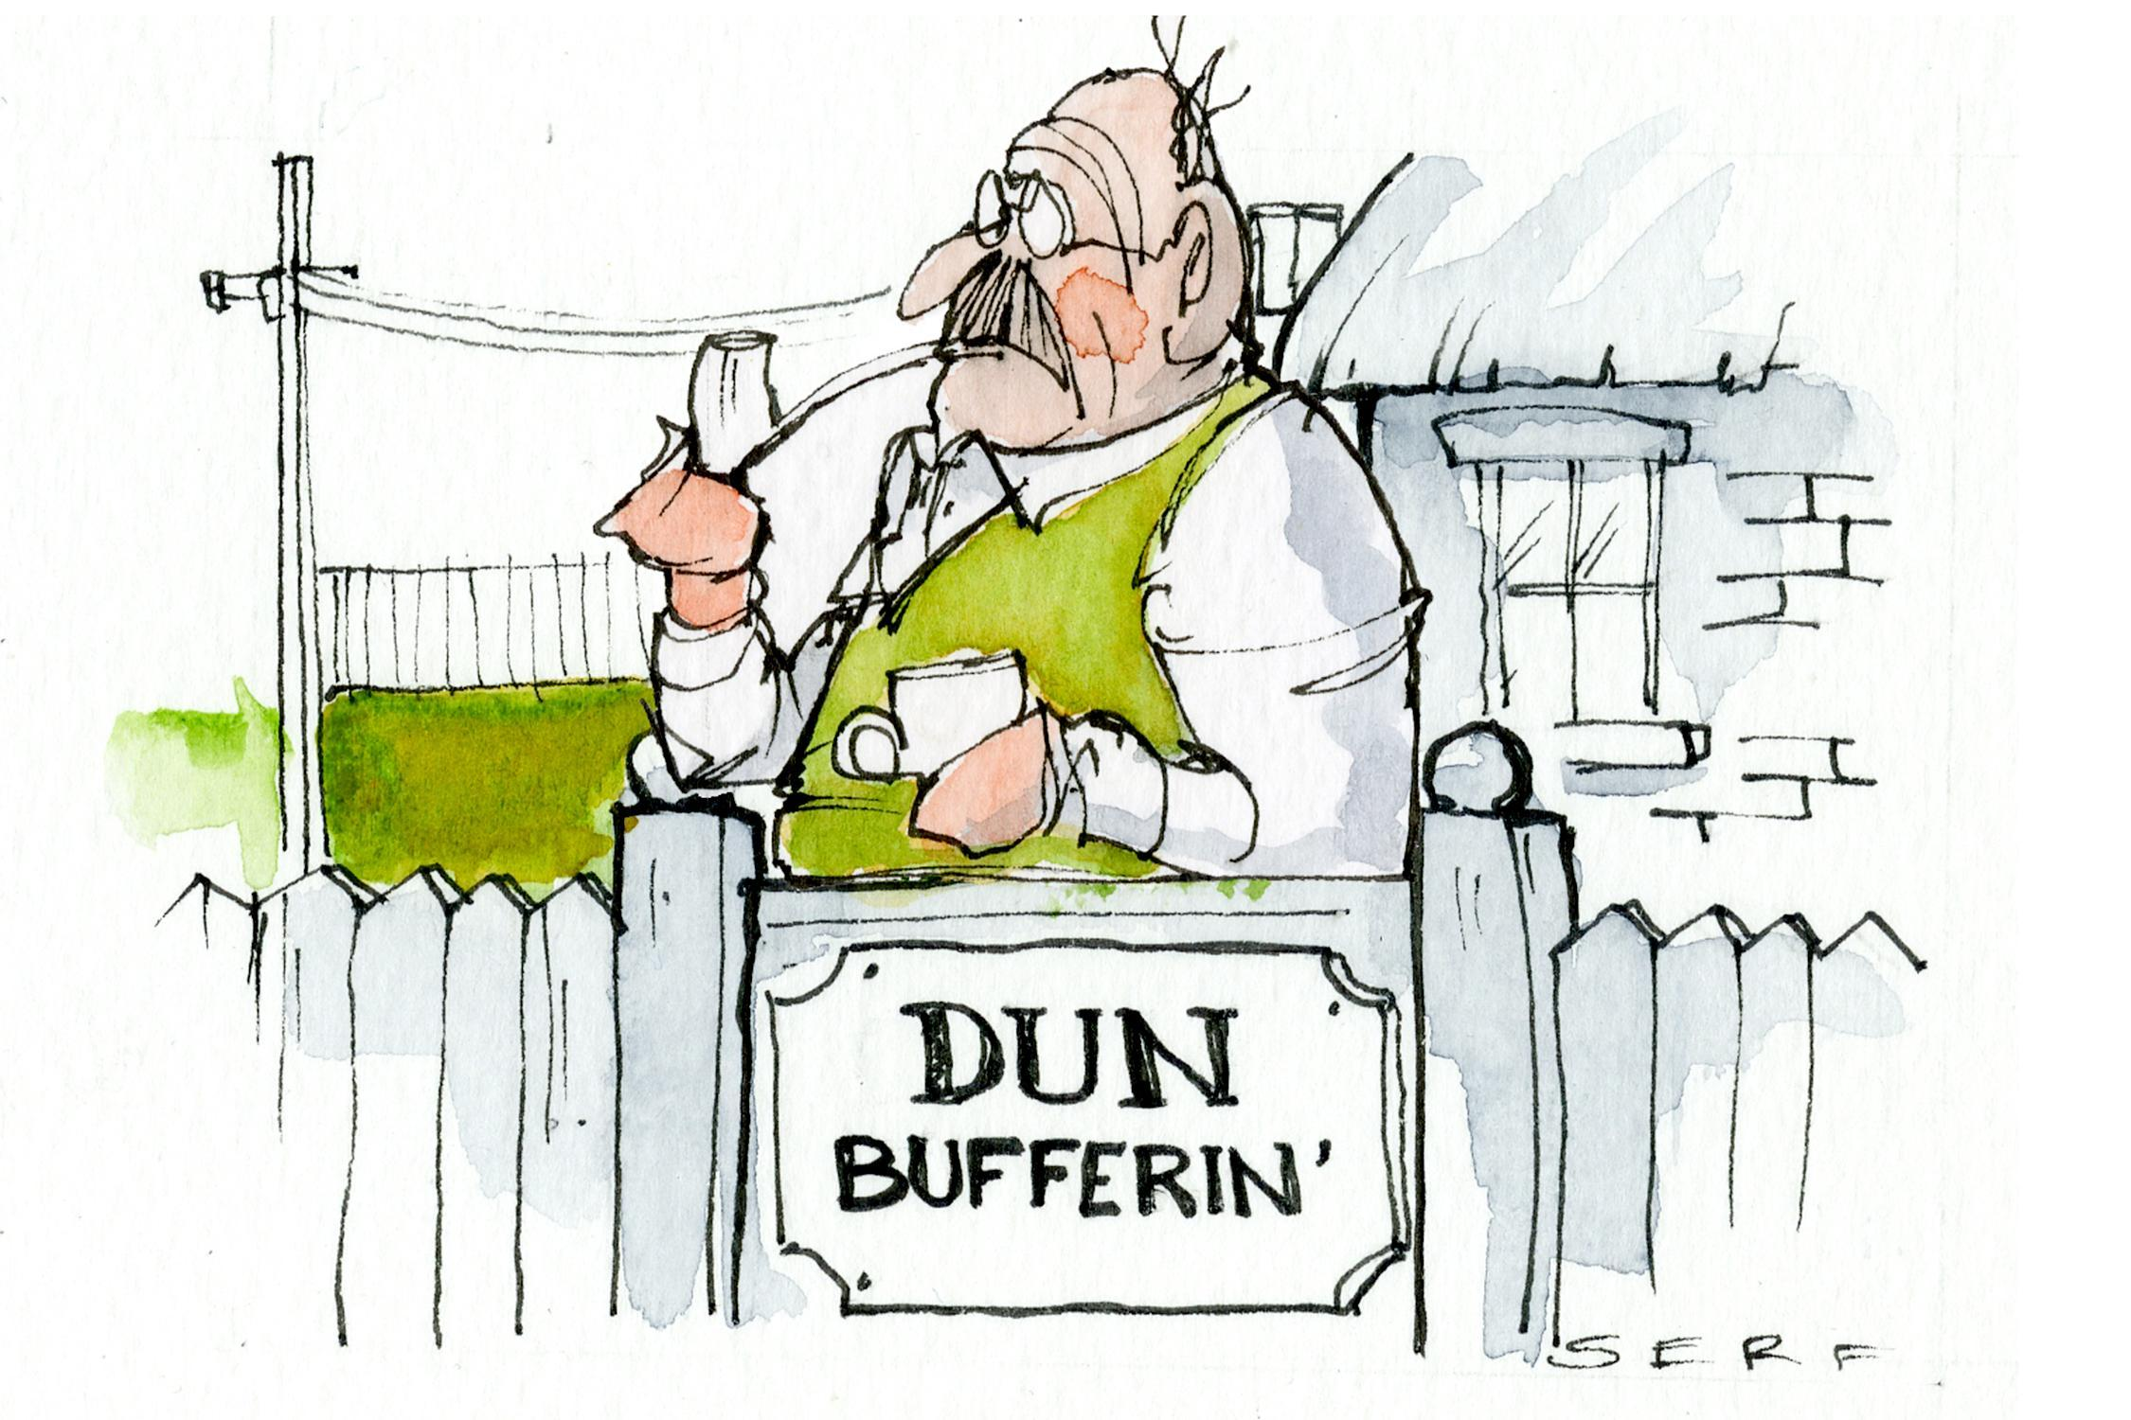

Slide 18
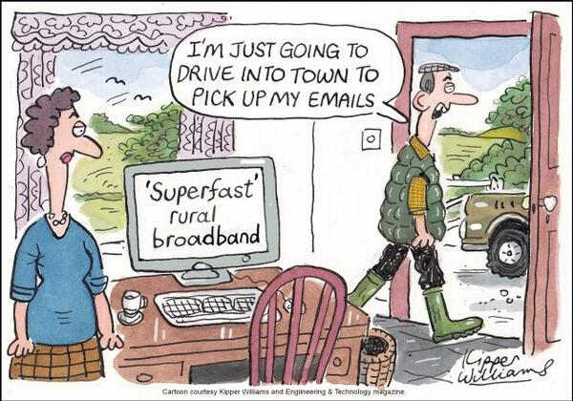
BROADBAND
The average broadband speeds in the majority of rural area types are lower than speeds in urban areas.
In 2014 the average broadband speed in rural hamlets & isolated dwellings in a sparse setting was 5 Mbit/s compared with 27 Mbit/s in major urban conurbations.

Slide 19
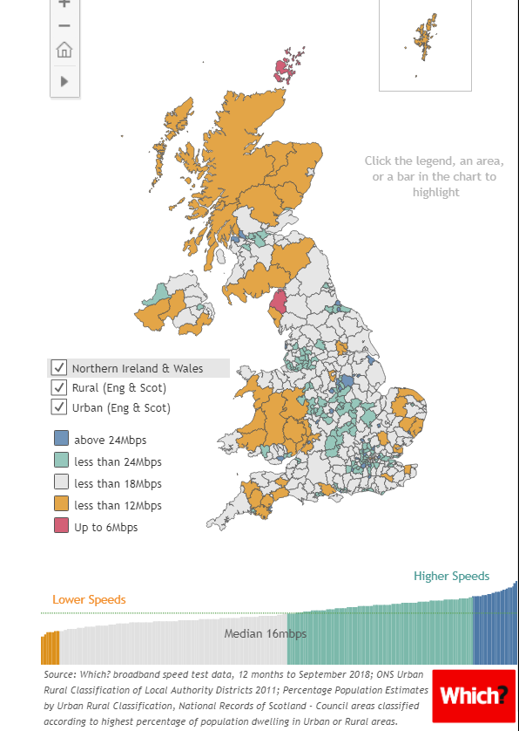

Slide 20
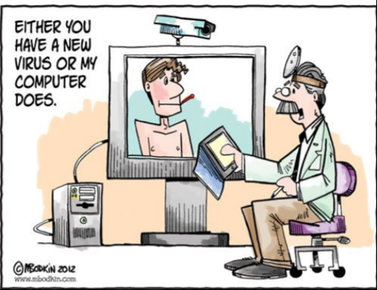
The potential to use technology

Slide 21
What impacts health in rural areas?
Health risks in rural areas
Access to health and social care services
Digital exclusion
Infrastructure
Population changes – migration, seasonal,
Housing and fuel poverty
Air quality
Social exclusion and isolation
Seasonal peaks and troughs in population
Employment and low pay
Disposal income – asset rich and income poor

Slide 22
Select Committee on the Rural Economy
What challenges do rural areas pose for the delivery of health and social care services, and how does health and wellbeing impact the rural economy?
What are the main challenges when it comes to recruiting and retaining staff to work in health and social care? How can rural areas attract the staff they need?
Are there sufficient education and training opportunities for people already living in rural areas or for people who would be interested in working in rural areas as health and care professionals?
What are the opportunities arising from new technology for delivering health and social in rural areas?
What are the main barriers to overcoming lonliness and social isolation?
Are preventative public health activities being adequately resourced?
What is the mental health situation and what can be done?
What role does the voluntary and charity sector play in delivering health and social care?

Slide 23
What challenges do rural areas pose for the delivery of health and social care services, and how does health and wellbeing impact the rural economy?
Health disadvantage and inequalities often hidden
Health data are biased towards an urban model
Seasonal or casual employment can mask the work situation
23.5 % over 65s compared to 16.3% (2017)
Highest proportions in Lincolnshire, Cumbria, Devon, Dorset, Somerset
Outward migration of younger people
Proportion of under 45s decreases with rurality
Financial poverty in rural areas concentrated in elderly – ¼ of population over 65
Recruitment and retention of health and care professionals
On average health appears better, but there are more older people
An urban model of healthcare delivery

Slide 24
What are the main challenges when it comes to recruiting and retaining staff to work in health and social care? How can rural areas attract the staff they need?
Centres of Excellence are in urban areas
Universities mainly city orientated
Career development – fewer opportunities in rural areas
Continuing education and development
Professional support, supervision and consultation - isolation
Housing costs
Transport to work
Family support

Slide 25
Are there sufficient education and training opportunities for people already living in rural areas or for people who would be interested in working in rural areas as health and care professionals?
Dispersed further education opportunities
FE training premium in rural areas
Higher costs in delivering vocational training
Too few rural facing medical schools
Joint clinical/academic positions less readily available

Slide 26
What are the opportunities arising from new technology for delivering health and social in rural areas?
Telemedicine
Online and other web based consultations
More accessible support for people in their own homes
Home monitoring for vulnerable individuals – visual, biomedical
Combatting loneliness; providing companionship
Volunteer and family support
Professional access to postgraduate education. Buddying.

Slide 27
What are the main barriers to overcoming loneliness and social isolation?
Better contact with distant families
Lack of understanding and supported networks for volunteering
Poor broadband speeds
Sensory loss - sight and hearing
Poor public transport
Diminishing local facilities and infrastructure
Relatively poor funding for health and social care

Slide 28
Are preventative public health activities being adequately resourced?
Rural per capita funding much lower than urban.
Population distribution increases need and costs (elderly; sparsity; lack of infrastructure)
Higher prevalence of obesity and smoking
Indications of greater mental health problems
Childhood indicators

Slide 29
What is the mental health situation and what can be done?

Slide 30
Mental Health
Rural areas apparently do better on depression and anxiety, BUT…..
Culture of self–reliance
More pronounced stigma in rural communities
Confidentiality may be compromised (e.g. home visits may be more visible)
Poorer access to services (Scottish Association for Mental Health)
Farmers have the highest suicide rate of any occupational group
Fewer doctors, nurses, social workers and therapists
Poorer provision – assertive outreach, crisis resolution, early intervention and diagnosis, rehabilitation, day care, psychotherapy, old-age psychiatry and community mental health teams
Scale of Rural Services 2016

Slide 31
What role does the voluntary and charity sector play in delivering health and social care?
Links to the community
Befriending, even at a distance
Requires organisational and communication capacity – funding, but cost effective
Training and safeguarding
Sector has specialised expertise in various areas – mental health; bereavement counselling; home help.
Willing to help, but don’t know what to do!

Slide 32
So what are some of the potential solutions?
National Strategy for Rural Health and Care
New model and different care management pathways
Currently a tweaked urban model.
Enhanced primary care and new ways of working
More minor surgery.
Nurse led consultations.
Pharmacy led prevention and management of long term conditions.
GPs as ‘Expert Generalists’.
Physician Associates.
Prescribing pharmacists, nurses, PAMs.

Slide 33
So what are some of the potential solutions?
Rural medicine and nursing as a speciality
Review professional boundaries across health and social care.
Inter-disciplinary training.
Enhanced roles for care workers.
Video consultations. Biomedical measurement. Counselling support.
Recruitment and retention incentives
Fewer NHS workers per head of population
Housing support
Interest free car loan scheme
Rural salary premium
International labour supply

Slide 34
So what are some of the potential solutions?
Data collection designed to reflect rural circumstances
Socio-economic situation.
Health, disease and inequalities.
Determinants and constraints on health
Rural proofing in national data sets
Differences between needs and assets in remote, rural and coastal areas

Slide 35
So what are some of the potential solutions?
Education, training and professional development
Rural universities
Flexible and open learning support
Apprenticeships
Interdisciplinary shared learning
Rural curriculum (Professional and Accreditation bodies)
Ongoing professional development/CPD
Buddying with major teaching centres (universities and students)
‘Ladders and Bridges’ approach to career progression

Slide 36
So what are some of the potential solutions?
Investment in the determinants of health
Housing
Economy and Employment
Education
Environment
UK National Eye and Hearing Survey
Sensory deprivation. Mobility. Independence

Slide 37
So what are some of the potential solutions?
Technological innovation
Remote examination and diagnosis
Biometric screening
Monitoring
Alarm
Patient records and referrals
Information and support

Slide 38
So what are some of the potential solutions?
Funding formula that represents the true costs
Staff time and travel
Distributed infrastructure
Incentives for recruitment and retention
Training
Pooled budgets for health and social care
Listen!
Staff. Local communities.

