Slide 1
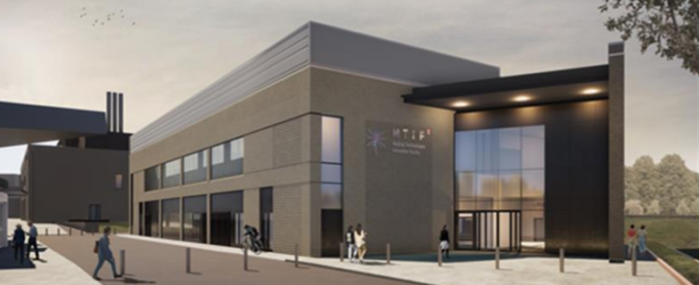
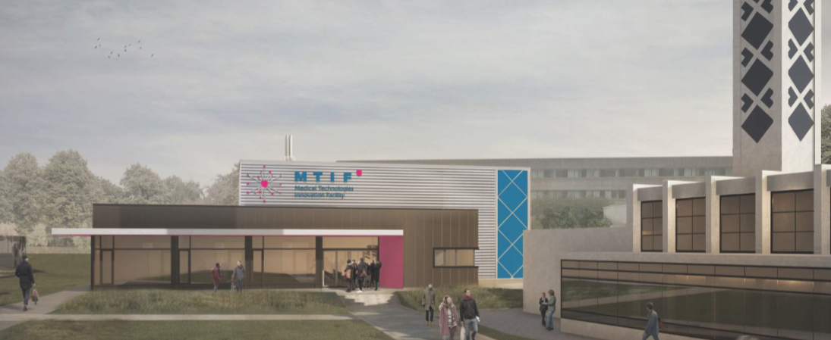
Medical Technologies Innovation Facility
MTIF

Slide 2
MTIF The Purpose
MTIF’s MISSION is to improve the quality of patient care by helping organizations to accelerate the development and commercial availability of innovative medical technologies and devices.
STRATEGIC PARTNERSHIP of stakeholders delivering complementary elements to help take your innovative Medical Technology from “bench to bedside”
Enabler as part of NTU’s Strategic Plan and
Strongly aligned to NTU’s research with impact agenda
Supports new STEM course portfolio investments

Slide 3
MTIF Objectives
To help organisations grow and accelerate product development activities in medical technologies and medical devices
Key Drivers
Key Assets
Collaboration & Community
Workshops & Laboratories
Transparency & Showcasing
Offices
Professional image & environment
Collaboration Space
Flexibility
Expert Research Staff Product

Slide 4
MTIF Concept
R&D Centre TRL 1-2
Construction and equipping of a multi-disciplinary research and innovation facility at the NTU Clifton Campus
Construction and equipping of a technology translation centre with clean rooms and Medical Technologies development laboratories on the Nottingham Boots Enterprise Zone
Translation Centre TRL 3-6
Collaborating with NHS teaching hospitals trusts; MediLink, Cheata, Boots, Biocity Group Ltd, EMAHSN as strategic partners to deliver complete product development and commercialiZation support
Strategic partners for commercialisation

Slide 5
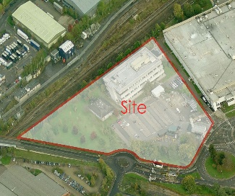
MTIF What do we offer?
A multi-partner integrated dual site medical devices research and development facility
Fundamental Research (TRL 1-2)
Commercialisation
(TRL 3-6)
NTU Clifton
Enterprise Zone
Laboratories and clean rooms (Class 10,000) available for rent
Laboratories and equipment available to industry
Business support team office
Communal hot desk working space and open innovation area
Communal hot desk working space and open innovation area
Single and double offices

Slide 6
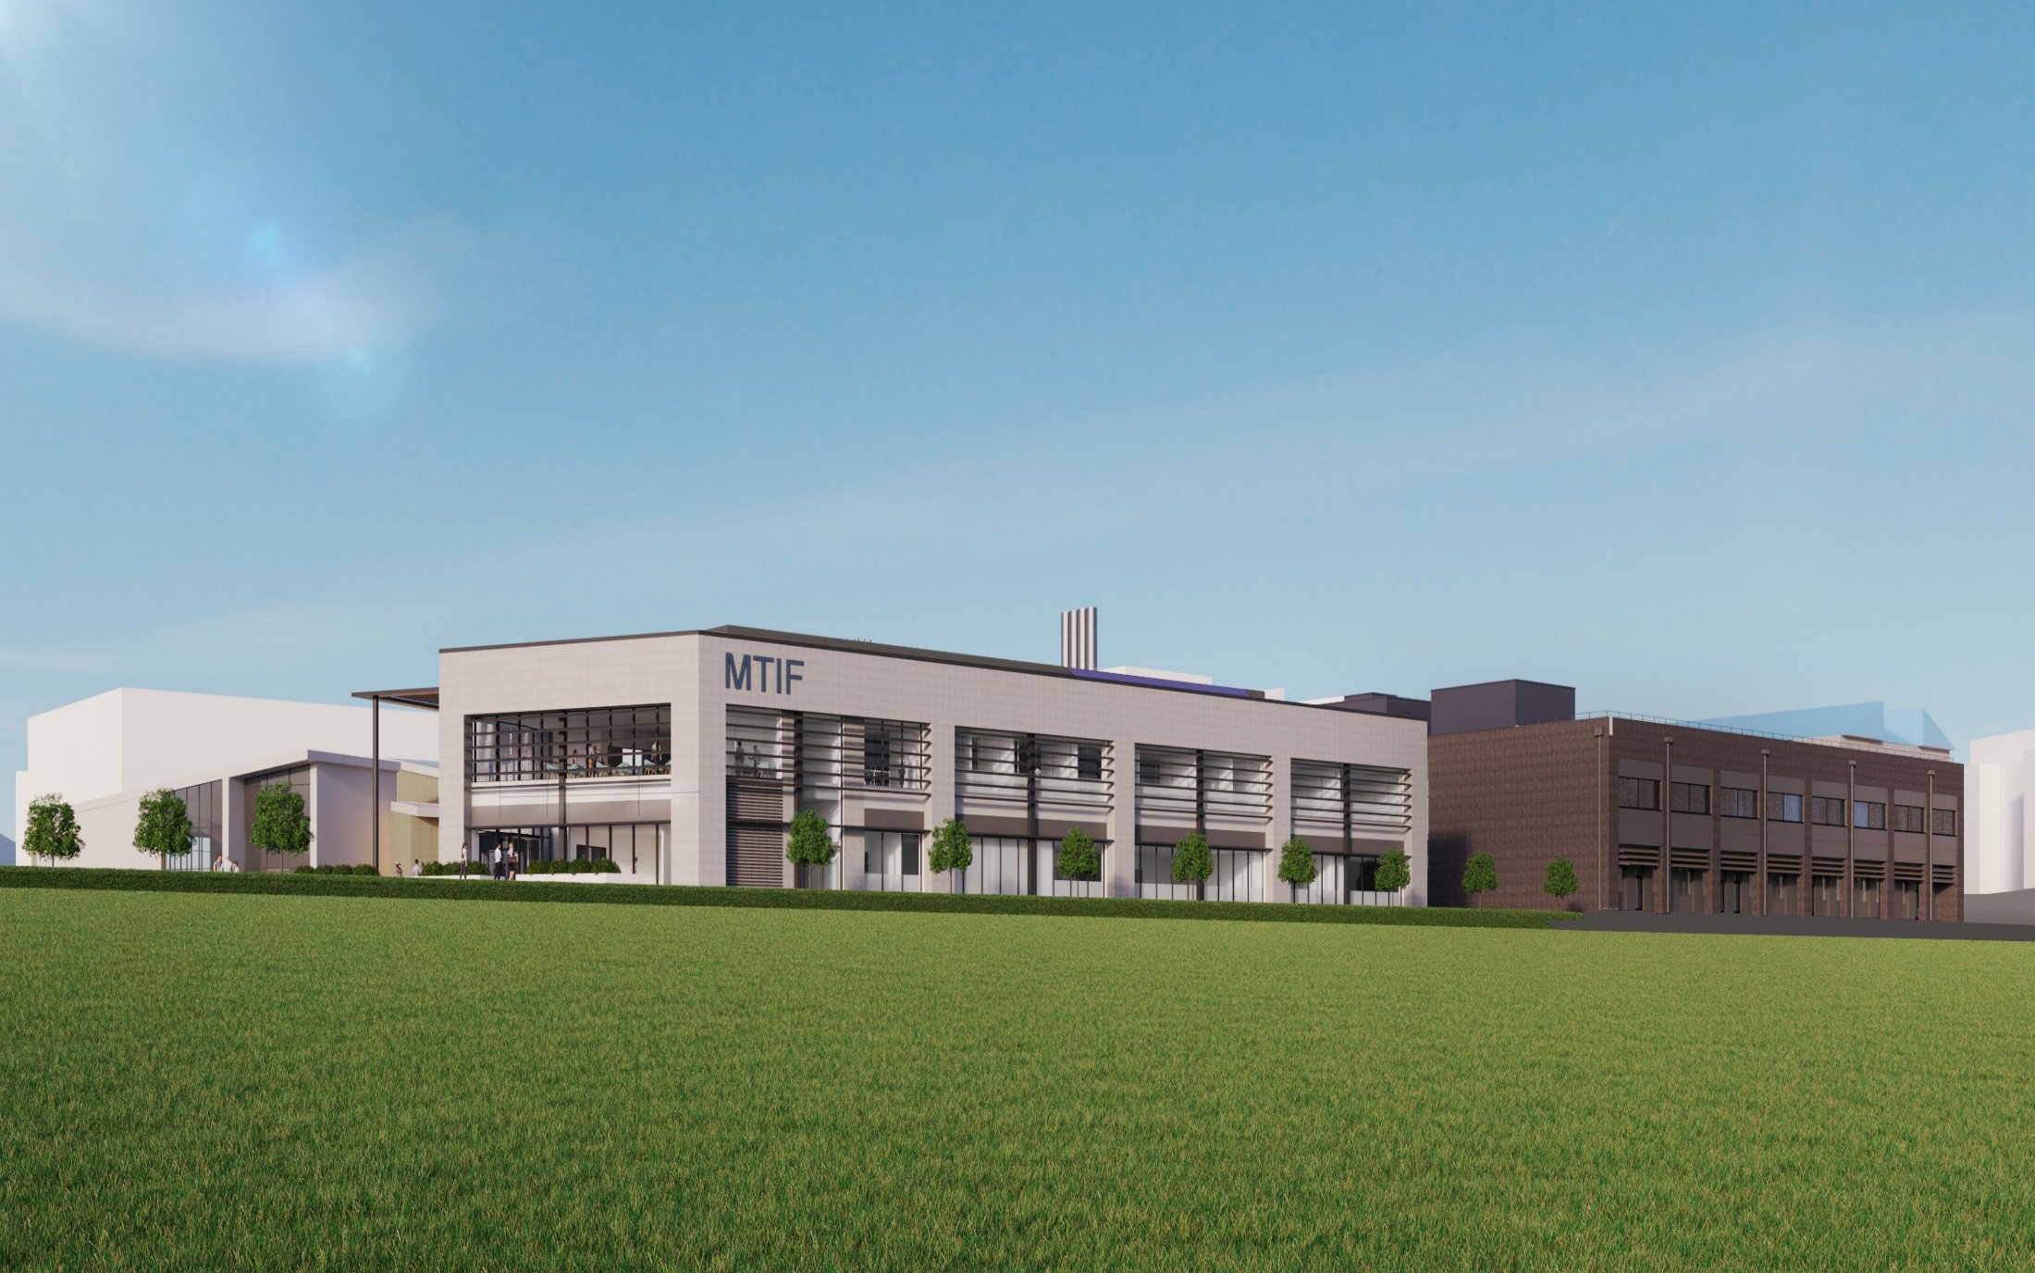
MTIF What’s inside - Clifton
Bioactive Surface Fabrication Laboratory Interactive, multicomponent and multifunctional material production and testing
Tissue Culture Room In vitro analysis of cells with materials in cultures as living human cells and tissues.
CAD Facility Design related data files and scans for 3D printing
Gray Room and Medical Device Prototype Test Facility Laboratory where devices are assembled.
Laboratory Clean Rooms ISO 5 cleanroom for materials deposition and device fabrication
Cognitive Robotics Laboratory Computing laboratory dedicated to development of assistive robotics medical systems
Workshop Fabrication and machining equipment
High Performance Computing Laboratory For intensive modelling and simulation of medical devices
Diagnostics and Analysis Laboratory Home for advanced instrumentation suite

Slide 7
MTIF What’s inside – Boots Enterprise Zone
3 Class 10,000 clean rooms for rent
Metrology Room
Autoclave room
Biocompatability standards and compliance testing lab
Collaborative working area
Business support services
4 offices for rent
Medical Device analysis and assembly

Slide 8
MTIF Staff Resources
Management (7)
Technical (24)
Managing Director
Research Fellows (10)
Chief Technology Officer
Project Manager/ Technologist (4)
Operations Manager
Development Engineer (6)
Business Development Manager
Technicians (4)
Business Acceleration Manager
Admin/Reception – Boots Enterprise Zone
Admin/Reception Clifton

Slide 9
MTIF Areas of Scientific Expertise
CELL MATERIAL INTERACES
ROBOTICS
DESIGN & PROTOTYPING
SMART TEXTILES
HUMAN FACTORS
MICROBIOLOGY
IMAGING

Slide 10
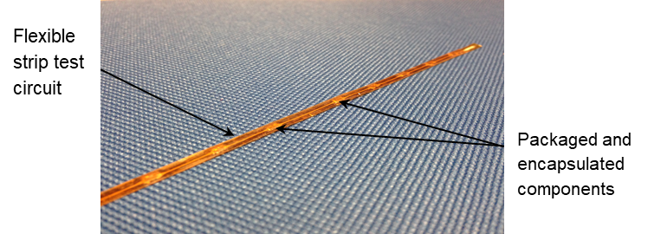
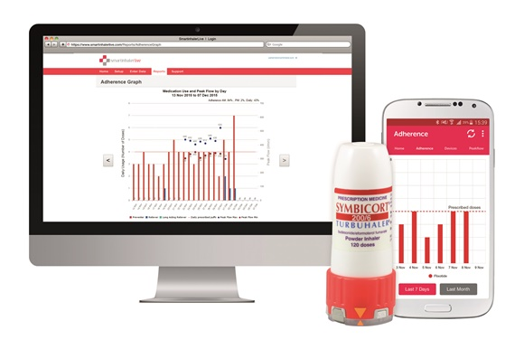
MTIF What do we offer for Rural Health & Care?
Integrated remote sensor monitoring supporting citizens to stay healthy at home
Sensors woven into fabrics for ECG, Temperature, Location, Acceleration.
Sensors can be built into devices such as inhalers,
Data can be collated and analysed remotely to identify physiological changes,
Patients can be seen when appropriate or interventions made electronically.
Fundamental Research (TRL 1-2)
Commercialisation
(TRL 3-6)
Laboratories and clean rooms (Class 10,000) available for rent
Laboratories and equipment available to industry
Business support team office
Communal hot desk working space and open innovation area
Single and double offices

Slide 11
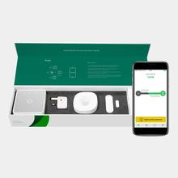
MTIF What do we offer for Rural Health & Care?
Big Data Analytics to support healthy ageing
Data from sensors in the home identify normal patterns of behaviour,
All sorts of sensors - When a kettle is normally switched on, when the fridge is opened, when the heating goes on, movement and falls.
Everyone is different but we are creatures of habit and changes to the normal routine may indicate problems,
Data analytics can develop a “normal” pattern and identify changes in the normal routine to trigger alerts or follow up calls to support citizens.
Fundamental Research (TRL 1-2)
Commercialisation
(TRL 3-6)
Laboratories and equipment available to industry
Business support team office
Communal hot desk working space and open innovation area
Single and double offices

Slide 12
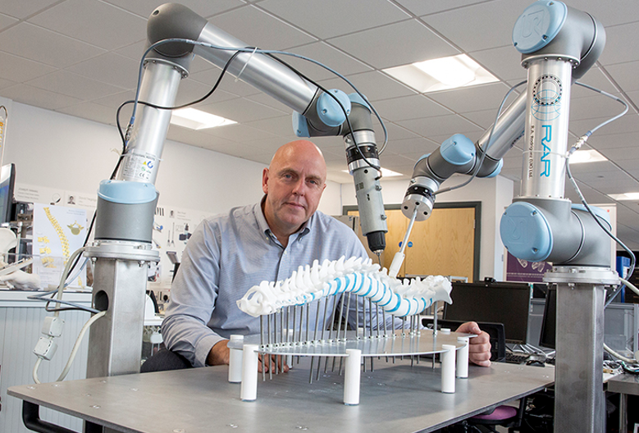
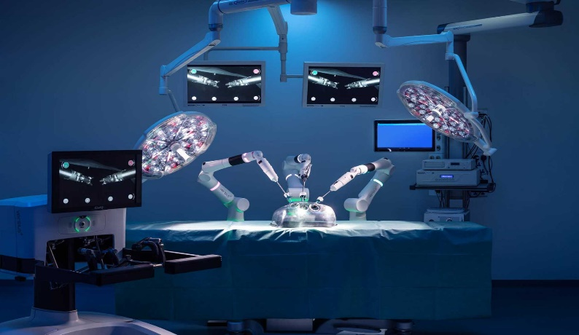
MTIF What do we offer for Rural Health & Care?
Remotely Operated Surgical Robots
Research in MTIF is supporting the development of surgical robots,
Advances have been achieved in complex spinal surgery ensuring greater precision and better outcomes for patients,
Remotely operated surgical robots are becoming a reality enabling surgeons to operate from different locations,
For rural populations this could enable patients to receive the best possible treatment wherever they are,
This may in some small way address the challenges of the rural health and care workforce.
Fundamental Research (TRL 1-2)
Commercialisation
(TRL 3-6)
Laboratories and equipment available to industry
Business support team office
Communal hot desk working space and open innovation area
Single and double offices

Slide 13
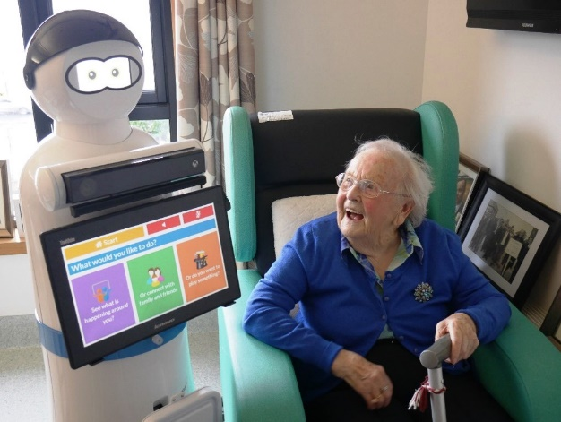
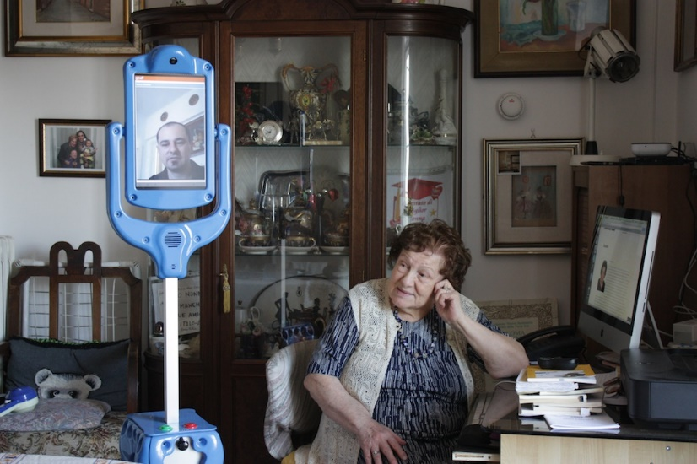
MTIF What do we offer for Rural Health & Care?
Companion robotics supporting carers
Assistive robotics are being developed to support individual citizens and carers to enable people to remain at home longer,
An ageing population with increasing health and care needs is placing an ever greater challenge on local government,
Assistive robots seem to provide an opportunity for identifying changes in people at home, providing visual links with carers and potentially providing companionship,
For rural populations this could be a game changer in providing elements of care at a time when the cost of care provision is escalating and the recruitment of professional carers is increasingly difficult.
Fundamental Research (TRL 1-2)
Commercialisation
(TRL 3-6)
Laboratories and equipment available to industry
Business support team office
Communal hot desk working space and open innovation area
Single and double offices

Slide 14
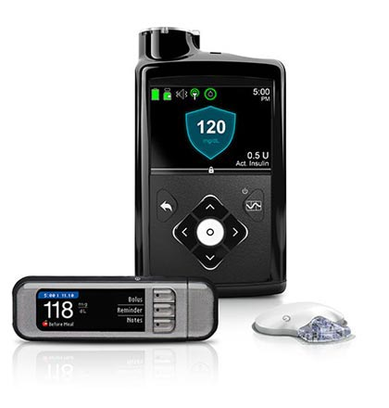
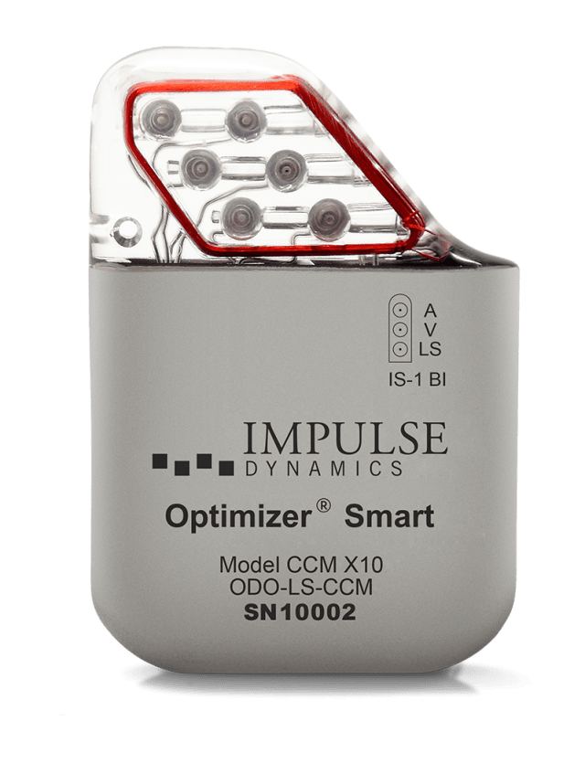
MTIF What do we offer for Rural Health & Care?
Developing the next generation of medical implants
Implantable medical devices have evolved dramatically with pacemakers, insulin pumps and drug delivery devices become more readily available,
Development is challenging and ensuring the body is able to accept the device is one of our areas of expertise,
Self adjustment using machine learning combined with remote monitoring by health professionals is possible but not widely used,
For rural populations remote monitoring and self adjusting drug delivery devices would enable patients physiological response to be monitored and optimised without endless visits to hospital.
Fundamental Research (TRL 1-2)
Laboratories and equipment available to industry
Business support team office
Communal hot desk working space and open innovation area
Single and double offices

Slide 15
MTIF Improving Rural Health & Care
by helping organizations to accelerate the development and commercial availability of innovative medical technologies and devices.
Fundamental Research (TRL 1-2)
Laboratories and equipment available to industry
Business support team office
Communal hot desk working space and open innovation area
Single and double offices

