Slide 1
Social Prescribing in Lincolnshire

Slide 2
What is Social Prescribing?
Enables primary care to refer patients with social, emotional or practical needs to a range of local, non-clinical services.
Takes pressure off GPs when a medical intervention is not appropriate or isn’t getting to the root of the individual’s problem.
Connects people to things in their own community to the benefit of their health and well-being.
Social Prescribing is:
One-to-one support, person centred, community-based, empowering lifestyle choices.

Slide 3
Who benefits from Social Prescribing?
Someone whose medical needs are managed/stable.
Someone who has been identified as requiring non-clinical support to manage some of their social issues.
People who are frail and feel isolated, lonely or anxious or may have low confidence or self-esteem.
Someone who has given their consent and is ready to engage in self-care/self-help activities.

Slide 4
Social Prescribing Christine's Story
https://vimeo.com/341089602/131217ce69?utm_source=email&utm_medium=vimeo-cliptranscode-201504&utm_campaign=29220

Slide 5
The story so far
Gainsborough pilot (June 2017)
Proof of concept (Sept 2018 to present)
1000 participants milestone passed July 2019
Growing evidence base of positive case studies
SROI – Social Value Engine, testing and early results.
INW and the Lincolnshire Care Navigation Model

Slide 7
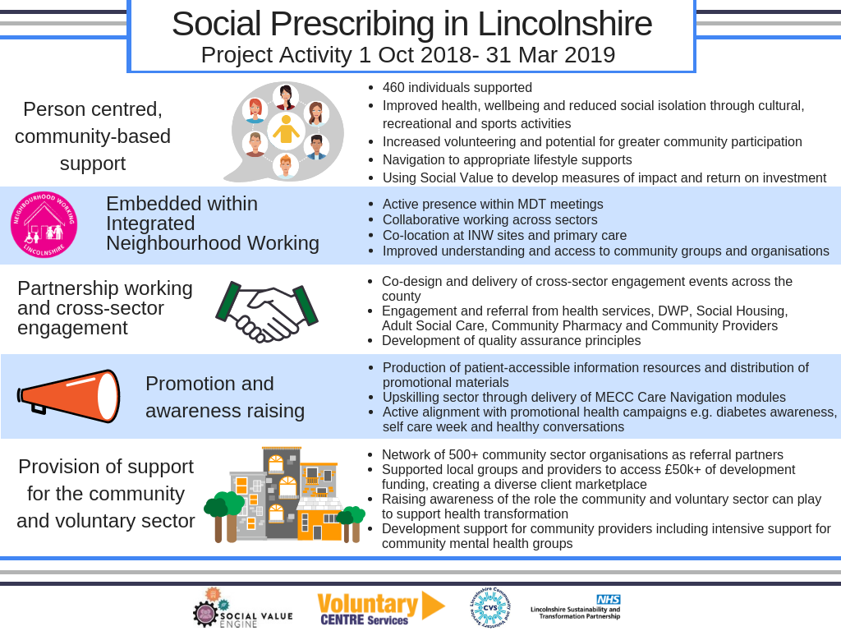

Slide 8
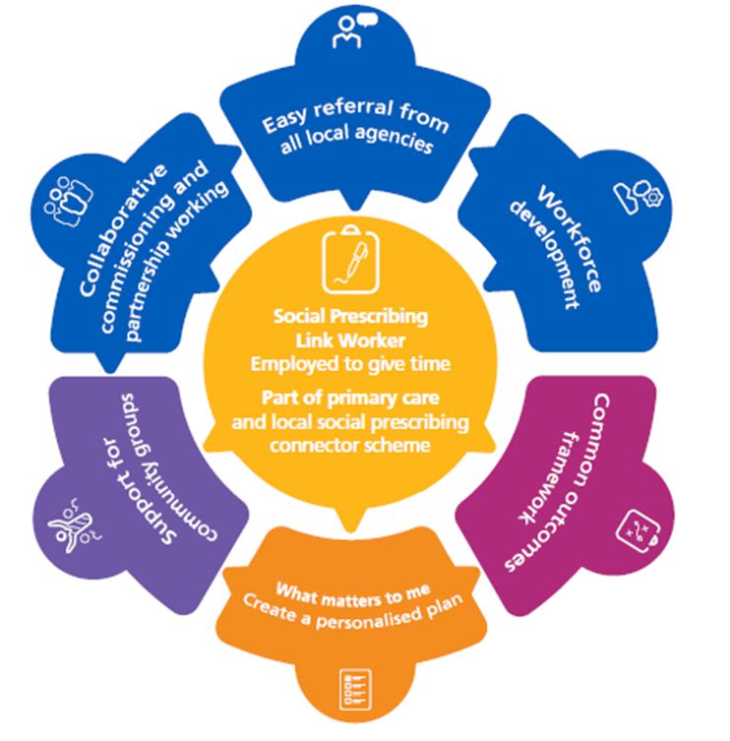
Lincolnshire Social Prescribing PCN Delivery Model NHS Long Term Plan: social prescribing and community-based support component of the Comprehensive Model of Personalised Care

Slide 9
Next steps & areas for development
Develop the current managed and co-ordinated countywide Social Prescribing Service
Co-design local activity with Primary Care Networks
Build social prescribing into the Vitrucare Digital Platform
Integrate with partner agencies and commissioned services supporting care navigation – ‘the ecosystem’
Joint planning and development – how are we going to take this forward?

Slide 10
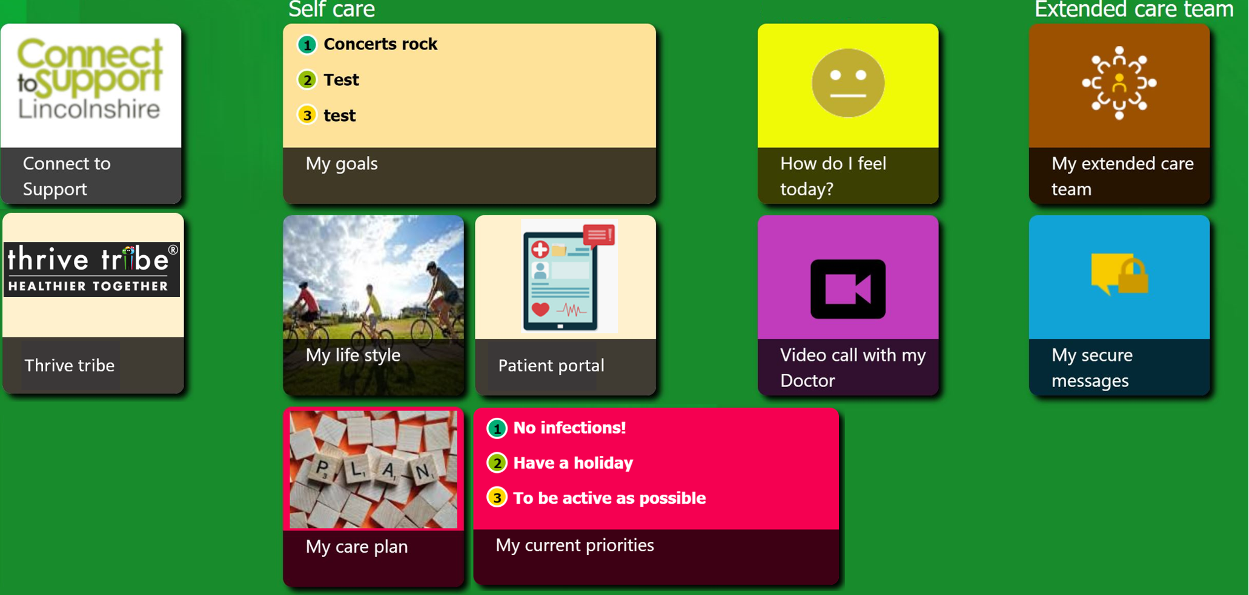
Vitrucare Digital Platform

