Slide 1
Greater Lincolnshire LEP
Local Industrial Strategy
LEP Board Meeting
29 October 2019

Slide 2
Purpose of today
To give a progress update to the LEP Board – process and LIS content
To review the draft LIS and discuss potential ambition statements
To agree next steps for Greater Lincolnshire and approach to co-production

Slide 3
Progress update

Slide 4
Where are we up to in the process?
Evidence Base Development
Insights and Logic Chains
Workstream Policy Papers
LIS drafting and internal review
Publication and Implementation
Engagement with the Independent Expert Panel, BEIS and other Government representatives, and local stakeholders
LIS Drafting and Internal Review
An initial draft of the LIS was prepared by the LEP with support from Metro Dynamics
Sections of the initial draft were shared with Greater Lincolnshire colleagues (within the LEP and local authorities) to refine the focus, bolster the interventions and reflect local priorities
The LIS was updated to reflect feedback from Greater Lincolnshire colleagues and incorporated into the draft presented to this LEP Board meeting.
Next steps are to refine the LIS following the LEP Board meeting, and begin co-production with Government.

Slide 5
Overview of LIS

Slide 6
Local Industrial Strategy on a Page
DRAFT AMBITION
Futureproofing the UK’s major agrifood economy, creating a productive and resilient economy built on natural capital and inclusivity
Energy and Water
Health and Care
Agrifood
Defence
Visitor Economy
Strategic Opportunities
Business environment
Ideas
Place
People
Infrastructure
Foundations of Productivity
Planning for Growth Objectives
Increase wealth by growing the economy and providing the right number and type of homes to meet housing need
Create a healthier society with a more engaged population
Improve quality of life, promoting wealth creation and growth from which everyone benefits
Ensure the economy, population and environment are resilient to future challenges, including climate change, and can benefit from future economic and technological opportunities

Slide 7
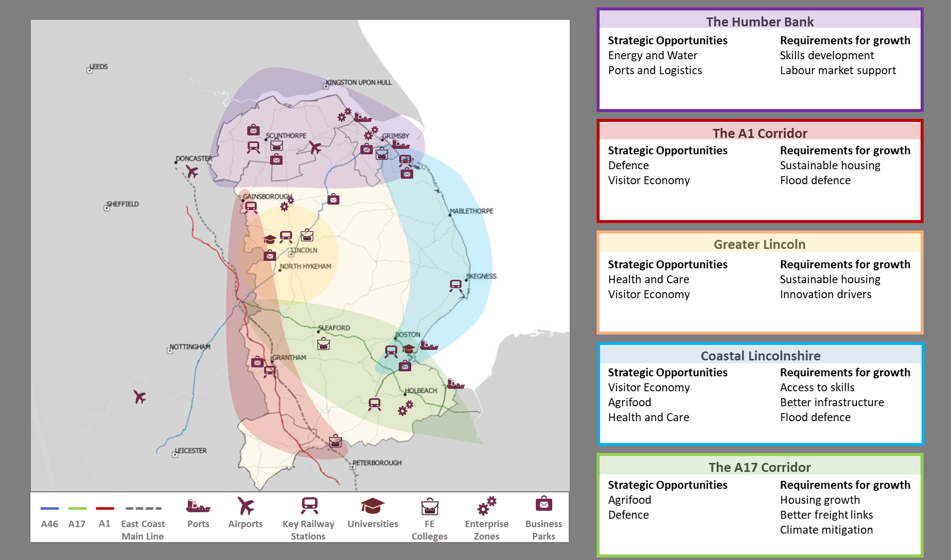
The Importance of Place to the LIS
The local industrial strategy is for the whole of Greater Lincolnshire and looks to maximise the gains for all places.
Urban areas are showing potential for growth
Rural and coastal areas are a core part of Greater Lincolnshire’s identity
One focus should be to grow resilient market towns
Understanding Place: Greater Lincolnshire’s Spatial Corridors

Slide 8
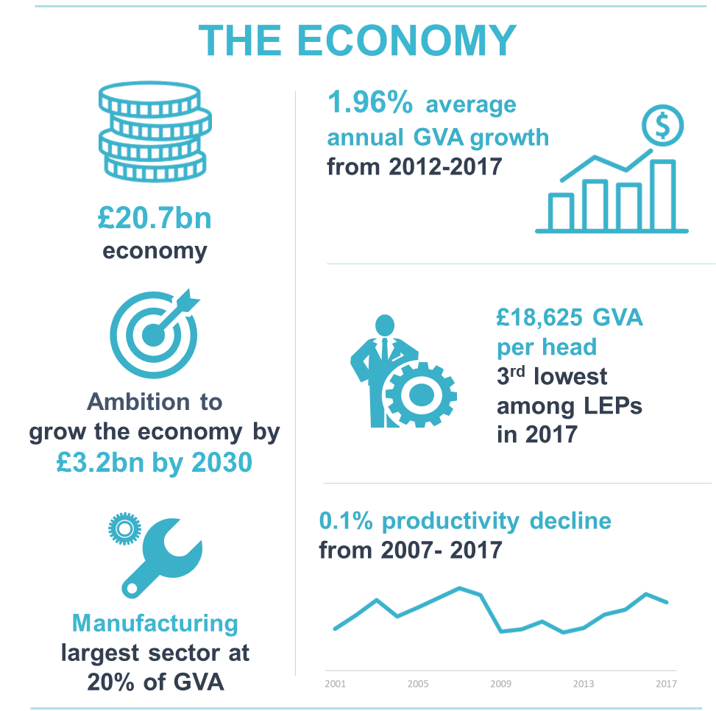

Slide 9
Developing metrics to measure success
Boost productivity
Raise wage levels
Grow together
All parts of the LEP area and sectors currently underperform the national average.
Greater Lincolnshire’s GVA per hour worked in 2017 was £27.40 - the 5th lowest across all LEP areas. This is 22.8% lower than the UK average.
if Greater Lincolnshire’s economy was performing at the national average it would add almost £9bn to GVA each year, a 45% increase in the total size of the economy.
32% of employees are paid below the real living wage. Employment is strong in sectors which tend to be labour intensive, relatively lower skilled and lower paid, and produce lower levels of value.
As of 2018, the median wage for full time workers in Greater Lincolnshire was £25,720, compared to £29,574 across the UK.
Some parts of Greater Lincolnshire rank amongst the most deprived areas of England as measured by the Index of Multiple Deprivation. There are pronounced pockets of deprivation along the Eastern coastal towns from Mablethorpe to Skegness.
Other areas such as Gainsborough and pockets of Lincoln are also in the bottom deprivation deciles.
Slow progress on inclusive growth in these most-deprived areas is a substantial challenge which must be addressed.

Slide 10
Strategic Opportunities

Slide 11
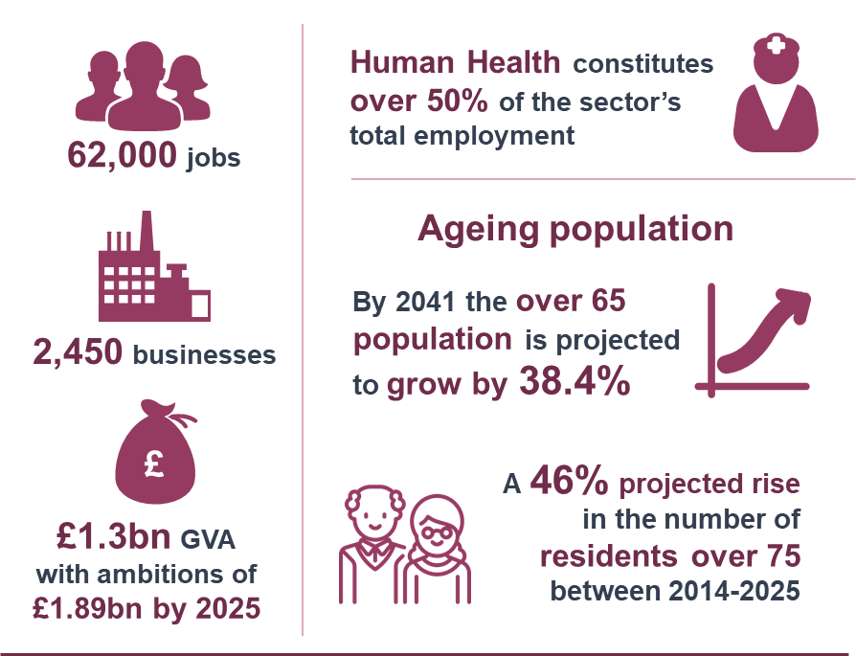
Health and Care
Ambition
Develop new models of care for a dispersed and ageing economy, building a cluster of local businesses to support active ageing
Summary of Opportunity
Health and care is a significant source of employment but as a sector it is relatively unproductive.
The health and care workforce will face 13,000 vacancies over coming years unless skills gaps are addressed.
The local industrial strategy is an opportunity to find innovative and cost-effective ways of providing quality health and care to an ageing and rural demographic.

Slide 12
Potential actions for Health and Care
Together, local partners will:
Pilot ‘Communities of the Future’ to meet the needs of an ageing population. This will explore improved physical and digital connectivity to local services and transformation of health and care services.
Develop Greater Lincolnshire as an international centre for innovation for rural H&C solutions, particularly through the National Centre for Rural Health and Care. This will involve partnering with the East Midlands Academic Health Science Network and the National Centre for Rural Health and Care.
Develop a pharmaceuticals network based around the science & innovation park to look at digital health – focus on virtual care networks to address spatial inequalities in deployment.
Address workforce challenges around skills and retention through promoting alternative career pathways and making Lincolnshire an attractive place to work.
Align activities of LEP Employment & Skills Board with NHS Lincolnshire Workforce Action Board.
Support actions to address the unsuitability of the current housing stock for an ageing demographic, and work to bring forward an adequate supply of housing which will enable more people to live sustainably at home for longer.
Transform the Health & Care sector by increasing the capability and involvement of the Voluntary & Community Sector to support deployment of H&C solutions as part of a Business Development Strategy.

Slide 13
Potential actions for Health and Care
Greater Lincolnshire wants to build on established links with HMG to develop the interventions outlined here.
Greater Lincolnshire is keen to engage with the following government departments and agencies for the Health and Care agenda part of the LIS:
DHSC with a focus on addressing the workforce challenges (in the context of the Interim People Plan) and realising the opportunities around the digital and technology agenda set out in the Long Term Plan;
DEFRA, with a focus on the development of a rural health and care rural proofing toolkit which could be piloted in Lincolnshire;
BEIS, with a focus on teams responsible for Universities around the development of our innovation proposals;
DfE, with a focus on workforce development;
MHCLG about support for issues in relation to housing and inequalities.

Slide 14
Agrifood
Ambition
Increase the international competitiveness of the agrifood sector by championing automation and resource efficiency to benefit its food chain
Summary of Opportunity
Agrifood is 18% of the local economy (compared to 3% nationally). And it is growing.
It is the source of 43% of new jobs and the heart of the sector’s technological innovation. This is a strong foundation for growth.
As new technologies arise and new processes develop there will be opportunities to deliver food more efficiently to a growing global population. The opportunity for Greater Lincolnshire is to capitalise on these trends to improve productivity.
Actions
Develop as a centre of innovation in all parts of the agrifood supply chain
Develop SmartLINC ERDF project (energy efficiency) and CERES Fund (food waste circular economy)
Promote uptake of automation through COTEMACO Interreg project, ERDF, and Growth Hub
Develop and implement a sector skills plan
Implement Water Management Plan with Water Resources East
Work in partnership with neighbouring LEP regions to growth the agrifood sector
Build on existing Hunan Lincolnshire partnership to grow bilateral trade

Slide 15
Energy and Water
Ambition
Become a rural innovation test bed for energy and water technologies and adopt new whole of system thinking to managing energy
Summary of Opportunity
Greater Lincolnshire is well placed to pioneer new approaches that contribute to the Government’s commitment to reach Net Zero UK carbon emissions by 2050.
Local businesses require a large and efficient supply of energy and water, in a dispersed and large geography – the LIS will support them.
Opportunity to focus on local and rural energy production and distribution and use the currently constrained energy infrastructure in a more efficient and affordable manner.
Actions
Become a testbed for the application of new energy technologies in rural contexts
Address existing local energy network capacity constraints
Target digital and engineering skills be developing a revised Education and Training Needs Assessment & Delivery Plan
Deliver a Carbon Neutral Business Zone
Support SMEs to engage with the circular economy through better information and guidance

Slide 16
Visitor Economy
Ambition
Grow the tourism sector yearly by building on recent investment and upgrades, promoting Lincolnshire as a leading tourist destination
Summary of Opportunity
50 miles of coastline, an area of outstanding natural beauty, and hundreds of visitor attractions contribute to a £1.47bn visitor economy sector which supports at least 39,000 jobs. There is an opportunity to capitalise on these assets and grow the sector.
Productivity in the sector is low, caused in part by the current seasonality of Greater Lincolnshire’s tourism offering and low wages.
A priority is to help provide higher-quality and more reliable employment for workers in the sector and increase productivity.
Actions
Produce a refreshed Visitor Economy Strategy
Develop a bid for a Tourism Zone
Create a sector skills plan
Upskill frontline workers to provide a more high-end hospitality experience
Support SMEs to adopt digital technologies
Create a destination marketing offer
Develop a ‘sustainable tourism’ strategy
Implement for Hotel Strategy for Greater Lincolnshire
Enhance and promote place offering to attract a greater number of high-spend visitors

Slide 17
Defence
Ambition
Create a cluster of Defence companies and become a first-choice destination for Defence-related industries, service leavers and their families
Summary of Opportunity
Greater Lincolnshire has a strong aviation heritage. There are 5 active RAF stations.
Under current plans, there will be significant RAF investment, plus a number of civil service and contractor posts will be created in order to support the development of core sites.
Maintaining and building on Greater Lincolnshire’s strength in defence will help boost productivity across the whole area and make sure the UK remains one of the best places in the world to innovate, do business and create jobs in the sector.
Actions
Explore opportunities for a defence cluster business park and workspace units
Maximise the support offered to RAF Leavers to develop further careers and opportunities within Greater Lincolnshire
Develop a business support programme for the defence sector focused on supporting new starts, spin outs and scale ups
Work with the defence sector and academic institutions to improve research and innovation capabilities

Slide 18
Foundations of Productivity

Slide 19
Foundations - Ideas
Ambition
Capitalise on recent momentum to enhance innovation, with twin priorities of deepening innovative activity in the strategic opportunity sectors and broadening the overall base of innovation occurring throughout Greater Lincolnshire.
Strategic Case
Encourage more innovative activity - beyond the 0.2% of GVA current R&D expenditure
Commercialise innovation - Greater Lincolnshire Innovate UK funding allocations have increased rapidly in recent years, experiencing a five-fold increase in just eight years, from £0.75m in 2010 to almost £4m in 2018.
Drive a step-change in innovative activity - to raise ambitions for innovation throughout the community or risk falling behind.
Actions
Stimulate and support wider innovation activity across all of Greater Lincolnshire
Equip businesses and industry leaders with the skills they need to innovate successfully
Turn focused excellence in innovation and research into commercial opportunities

Slide 20
Foundations - People
Ambition
Develop skills and talent across Greater Lincolnshire and develop a flourishing and inclusive economy with a more responsive skills system that creates better opportunities for all.
Strategic Case
Focus on inclusive growth –over 30% of workers earn below the real living wage
Grow the pool of higher-level skills - between 2008 and 2018 there was an 8% increase those with NVQ4
Address replacement demand and deficit of young talent - over 207,000 projected job vacancies by 2024
Match skills to business need - over 20% of Greater Lincolnshire’s job vacancies are due to skills shortages
Actions
Continue efforts to equip the workforce with high-quality, relevant training
Develop a programme to support residents to participate in the workforce
Partner with businesses to help them adapt and compete

Slide 21
Foundations - Infrastructure
Ambition
Ensure Greater Lincolnshire has the infrastructure it needs to support businesses, connect people, and be prepared for future growth and challenges
Strategic Case
Improve transport connectivity within Greater Lincolnshire and out to other destinations
Maximise the value of ports
Improve digital connectivity, particularly in rural areas
Improve flood defence and water management
Ensure utilities support local growth
Actions
Develop and publish a Greater Lincolnshire Strategic Infrastructure Delivery Plan by early 2020
Improve inter- and intra- regional transport connectivity
Provide businesses with the digital infrastructure they require to grow and innovate
Ensure water is managed effectively as a strategic asset, an industrial input and as part of the area’s natural capital

Slide 22
Foundations – Business Environment
Ambition
Create a supportive environment for entrepreneurs, micros and SMEs to grow and become more productive and resilient
Strategic Case
Prioritise business start ups and growth – currently a negative net business birth rate
Engage the global economy - building on the £4.7bn exports annually & ideas for a Free Port
Increase business engagement with digital technology - uptake of digital technology is currently low
Provide businesses appropriate sites and premises – including the enterprise zones
Actions
Support all businesses to grow, build resilience and raise productivity through effective use of technology solutions
Maximise the opportunities of the circular economy and energy for all businesses
Develop Greater Lincolnshire’s place in the global economy
Focus on tailored interventions to capitalise on our areas of strategic opportunity

Slide 23
Foundations - Place
Ambition
Capitalise on the dispersed economy to create a leading polycentric, productive economy
Strategic case
Protect Greater Lincolnshire’s distinctive and strategic natural capital
Meet housing needs - addressing low activity and land values in housing market, particularly in areas with flood risks
Prioritise inclusive growth - providing solutions to promote inclusion is vital in terms of inclusive growth and increasing the prosperity of areas.
Actions
Work together to make towns stronger, not individually but collectively
Invest in infrastructure improvements and complement this with reach to pockets of rural isolation
Develop a new local approach to delivering 100,000 homes.

Slide 24
Questions for consideration

Slide 25
What are the main takeaways from the LIS? (1)
We are a manufacturing broad-based economy, with distinctive opportunities in a number of areas based on our assets, sectors, and investments
Agrifood and energy and water – capitalise on existing sector strengths and assets
Health & care and visitor economy – major employers with potential to be more productive
Defence – important aviation history and potential for catalyse a new sector / supply chain opportunity

Slide 26
What are the main takeaways from the LIS? (2)
Our R&D activity starts from a low base but there are signs that it is growing, we aim to triple R&D spend through the LIS
The working age population is shrinking, with increased demand by employers for higher level skills, we will upskill, retrain and retain talent through the LIS
The dispersed and rural economy requires renewed investment in infrastructure regionally, nationally and globally, we will take a strategic and integrated approach to future proof the region to respond to challenges and opportunities
We will create a supportive business environment for our micro, small and medium sized enterprises, distinctive to other places as they are both the largest proportion of the business base by size and employment
The area’s scale and dispersed economy make it challenging to reach all businesses and individuals, with a strong inclusion challenge, but Greater Lincolnshire’s places and natural capital is also the area’s strongest asset – we will support all places to grow through the LIS

Slide 27
What should be the LIS Ambition / mission statement?
Current proposed ambition: Futureproof the UK’s major agrifood economy, creating a productive and resilient economy built on natural capital and inclusivity
Other potential ambitions:
Grow productivity, wage levels and inclusivity through pursuing strategic opportunities that maximise the value of Greater Lincolnshire’s abundant natural capital and rural economy
Capitalise on Greater Lincolnshire’s distinctive offering as a rural place with networks of small businesses to create a productive and resilient economy built on natural capital, inclusivity and a future-focused agrifood sector
Harness Greater Lincolnshire’s distinctive offering as a rural place with a strong manufacturing base and large network of small businesses to grow a productive, inclusive and resilient economy

Slide 28
Questions to consider
Does the single overarching ambition for the LIS capture what is most important to Greater Lincolnshire?
Will the proposed metrics help focus local partners on actions which make the greatest difference to Greater Lincolnshire’s productivity and people?
Do the actions and priorities encompass the depth and breadth of activity which needs to occur?

