Slide 1
India’s rural healthcare system: some lessons
Presentation to All Party Parliamentary Enquiry
Dr Pavitra Mohan, MD, MPH
Secretary, Basic Health Care Services, India

Slide 2
Some context
Population: 1.2 billion
Proportion rural population: 72%
Per capita income:
Urban: £ 1015
Rural:£ 422
Population density
New Delhi: 11, 312/ sq. km
Udaipur Rural: 262/ sq. km
Per capita expenditure on health:
India: $69
Other LMICs: $80

Slide 3
Bhore Committee (1946)
Following world war-II, at the time NHS was being formed, in India, a committee led by Sir Joseph Bhore (of Indian Civil Services) conducted a health survey.
In 1946, the committee presented the findings to Indian parliament, noting:
"If it were possible to evaluate the loss, which this country annually suffers through the avoidable waste of valuable human material and the lowering of human efficiency through malnutrition and preventable morbidity, we feel that the result would be so startling that the whole country would be aroused and would not rest until a radical change had been brought about".
Recommendations of the committee formed the basis of rural healthcare after India’s independence

Slide 4
Rural healthcare structure in India
dary healthcare
Primary Health Care

Slide 5
Services at primary healthcare
Preventive:
Vaccination
Care during pregnancy
Promotive:
Health education
Counselling
Primary Curative:
Communicable
Non-Communicable
Maternal-Child

Slide 6
Redesigning: National Rural Health Mission (2005-2015)
Communitization
Patient welfare society
Village Health and Sanitation Committee
Accredited Social Health Activist (ASHA; hope)
Financing districts as per need; not capacity or performance
Decentralised planning (based on local needs)
Incentives for safe childbirth

Slide 7
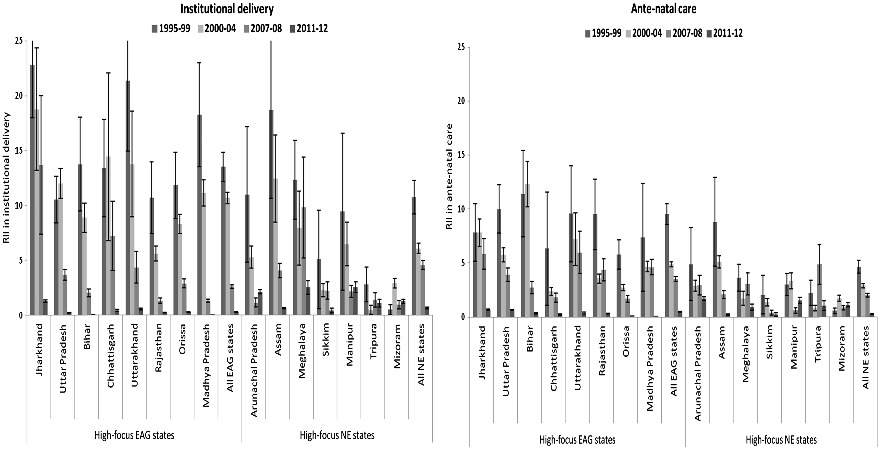
Impact of National Rural Health Mission on promoting equity in utilization of healthcare
Figure-1: Inequities in Wealth-related relative index of inequality (RII) in the uptake of institutional delivery and ante-natal care
Notes:
Figure 2. Wealth-related relative index of inequality (RII) in the uptake of institutional delivery and ante-natal care in pre-NRHM periods (1995–99 and 2000–04) and post-NRHM periods (2007–08 and 2011–12), in high-focus empowered action group (EAG) and north eastern (NE) Indian states. Notes: (i) Authors estimates from the DLHS and the AHS data. (ii) The RII value reported in the figure is (RII-1); (iii) positive values of the reported RII denotes inequity in favour of the rich; (iv) error bars denote 95% confidence intervals.
Unless provided in the caption above, the following copyright applies to the content of this slide: © The Author 2016. Published by Oxford University Press in association with The London School of Hygiene and Tropical Medicine.This is an Open Access article distributed under the terms of the Creative Commons Attribution License (http://creativecommons.org/licenses/by/4.0/), which permits unrestricted reuse, distribution, and reproduction in any medium, provided the original work is properly cited.

Slide 8
Community health activist: ASHA the hope
Only village level link
Health promotion
Link to services
Community based distribution
Escort for referrals
Home based care of newborns
Palliative care!!

Slide 9
Impact of ASHAs on utilization of maternal health services
Exposure to ASHAs was associated with:
17% increase in the utilization of at least one antenatal care visit
5% increase in the utilization of 4 or more antenatal care visits
26% increase in skilled birth attendance
28% increase in giving birth in a health facility

Slide 10
Remote, rural areas: AMRIT Clinics
Population norms do not work for remote areas
Doctors are difficult to engage for staying in remote areas
Social determinants such as nutrition and livelihoods critical
Many young women from such areas taking up nursing as a profession:
More likely to be empathetic and communicative with the communities

Slide 11
AMRIT Clinics
AMRIT Clinics are not-for-profit clinics in remote, rural areas
Led by nurses, supported by physician and community workers
In community premises, oversight by a community group
Partner with other NGOs for addressing social determinants
Appropriate use of technology
Tribal nurses are likely to stay on and perform better than non-tribals

Slide 12
Integrating social care (1): Loan to patients with Tuberculosis: Partnership of BHS and RSSA (micro-credit company)
To curb dropouts caused by urge to migrate back or work and earn for the family
Combination of timely detection, treatment, follow-up care and financial assistance (loan) of INR 18,000 – 20,000 (given in installments on monthly basis) for TB patients
Ensuring full treatment adherence
Loan supported in the reduced/ absence of liquid cash in the household
Patient profile:
100% tribal; 10% women
100% patients were the prime earners in the family
60% patients were migrant workers
96% patients had pulmonary tuberculosis
Focus on rest and nutrition
The amount was utilized in procuring nutritious food items for consumption such as meat, fish
Recovery and integration with labour markets remained a challenge as the deterioration of health made them unfit for rigorous manual work
56 patients enrolled for TB loan
59% newly detected TB patients
Treatment adherence
97%
53% recovery rate of principal loan amount

Slide 13
Integrating social care (2): Kitchen gardens
Poor dietary practices and inadequate food contribute to large burden of communicable and non-communicable diseases
Kitchen gardens and backyard poultry promoted by AMRIT Clinics
Led to a significant increase in intake of vegetables

Slide 14
Integrating social care (3): day-care centers for children
Lack of childcare affect children’s growth and development; and mother’s potential for employment
Day-care centers provide nutrition, care and play for children; and opportunities for rest and employment for mothers
We see significant improvement in nutrition, and learning abilities

Slide 15
Times of COVID
Value of distributed community based care for ensuring continuity:
Footfall increased by 33% in AMRIT Clinics
Mounting response to food crisis following lockdown:
Community network of volunteers
Community presence and understanding
Surveillance and containment

Slide 16
Summary learnings
1. Financial allocations based on need rather than performance
2. A health facility based on “time to travel” rather than population
3. Community Health Worker critical for:
improving behaviours
utilization of services
Equity
Social care makes services responsive to needs
Publicly funded childcare
Integration of public health functions help prevent and contain epidemics

