Slide 1

Community Council for Somerset
Keeley Rudd. CEO

Slide 2


Slide 3



Slide 4

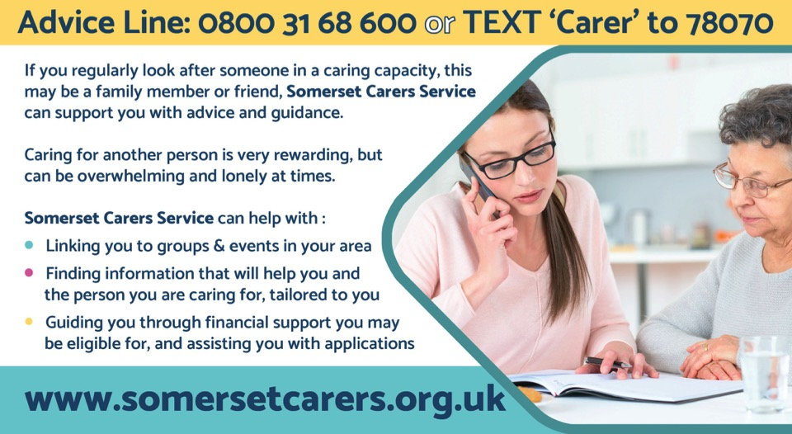

Slide 5

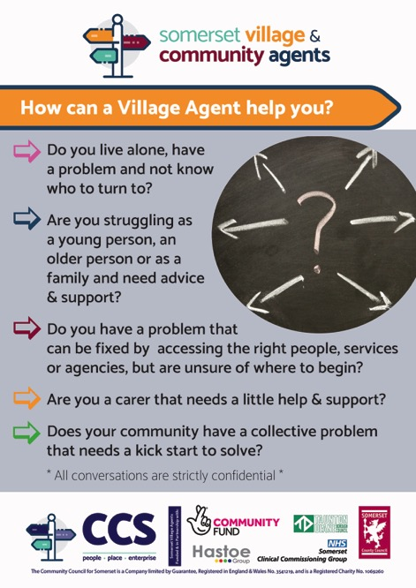

Slide 6
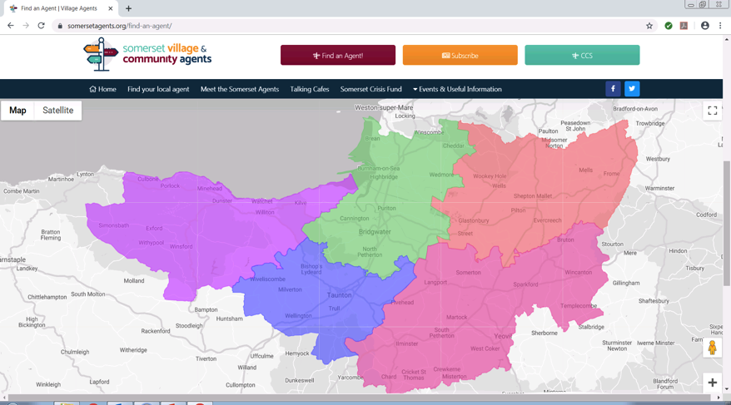

Slide 7
Resource – 57 Agents
20 Village Agents
9 PCN Village Agents
1 Macmillan Village Agent
7 Mental Health Village Agents
9 Community Agents
3 Home First Community Agents
7 Carers Agents plus 1 Advice Line/support Officer
1 Village Agent Transport

Slide 8



Slide 9

Our Village, Carers and Community Agents have established many weekly Talking Cafes throughout Somerset
For full details go to
https://somersetrcc.org.uk/our_work/supporting-individuals/talkingcafe/
Or find us on Facebook www.facebook.com/talkingcafesomerset

Slide 10


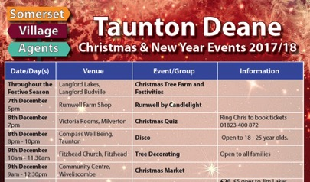
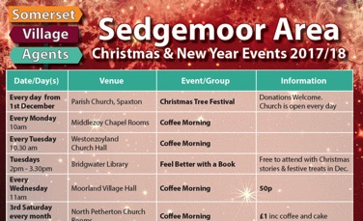
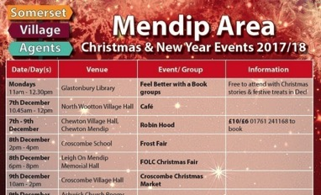

Each year we collate as much detail on Christmas events across each district and publish them for all to use.
The Christmas Directory is used extensively by the public, as well as support agencies & our own agents in trying to combat loneliness during the festive season

Slide 11

Novel Approach to GP/ Specialist Accreditation – Exploring the CESR / CEGPR route
Gajendran Kanagalingam
Wye Valley NHS trust

Slide 12
Who is involved in this project
Dr Jayne Clarke – Consultant Paediatrician with Special Interest in Respiratory Medicine and Associate Medical Director of Education ; Project Sponsor
Dr Gajendran Kanagalingam – Specialty Doctor in Obstetrics and Gynaecology ; Project Lead
Dr Jessica Alcena – Specialty Doctor in Acute Medicine ; Project Co-Lead

Slide 14
What is CESR?
CESR = Certificate of Eligibility for Specialist Registration
doctors in a non training post
show evidence of knowledge, skills and attributes of a consultant to the GMC
holders can apply for substantive consultant post
equivalent to CCT (a GMC approved regional consultant training programme )
Notes:
As such the application system is set up to prove current working standards and practice
Initially intended for non EU consultants to practice in UK as a consultant so expected to be working at junior consultant level

Slide 15
Benefits of CESR
Royal Derby Emergency Department
  Retention rate increased to 92% from 63%
  Staff morale and job satisfaction improved
  CESR portfolio adapted as toolkit for implementation nationwide to increase consultant workforce in Emergency Department
  Saving up £330 000 ,every year through less agency spend and more substantive post being filled in
  Similar experience in Harrogate and District NHS and University Hospital of Southampton

Slide 16
Why was it undertaken ?
Increase recruitment and retention of SAS/LED workforce
Increase job satisfaction
Scoping CESR feasibility in all relevant department
Offer and encourage participation in extended roles for management and quality improvement
Recruitment incentives
Offer secondment opportunity to tertiary centre to improve job skill and fulfill CESR portfolio requirements
Improving worklife balance
Introduce Less than Full Time working option
Establishment of CESR database
Support attendance at QSIR course and NHS Leadership courses ie Mary Seacole
To include secondment opportunity in job advertisement

Slide 17
How was it undertaken ?
Research the CESR programme, produce a summary paper to evidence this
Arrange meetings with consultants, teams, SAS doctors to scope provision/opportunity
Design and populate a CESR database
Validate the database with the teams and share with stakeholders

Slide 18
How was it undertaken ?
Met with clinical leads of all departments
Compiled which part of the curriculum can and can’t be offered in WVT
Secondment opportunity explored
Attended CESR workshop day organised by GMC
Database launched and shared with key stakeholders at a information and update session
Good feedback

Slide 19
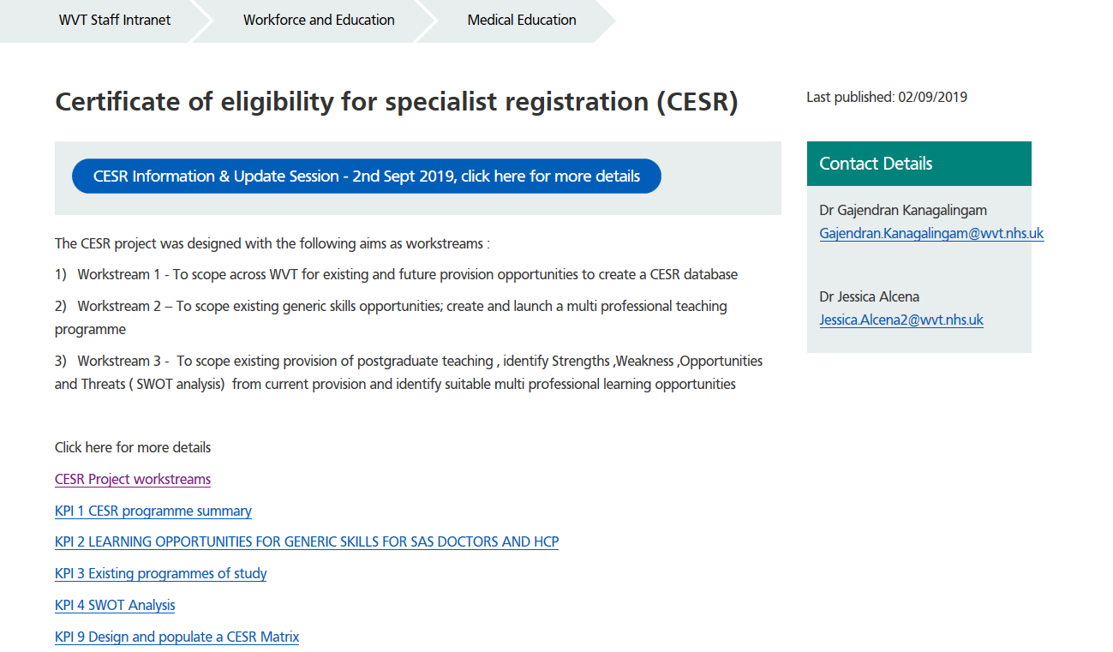
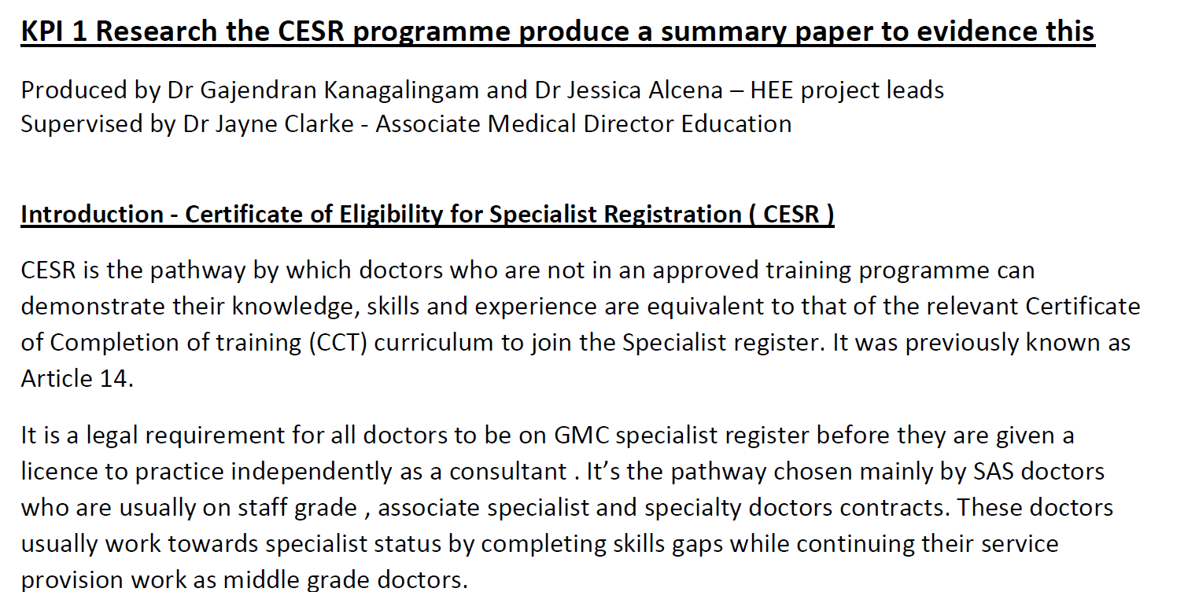

Slide 20
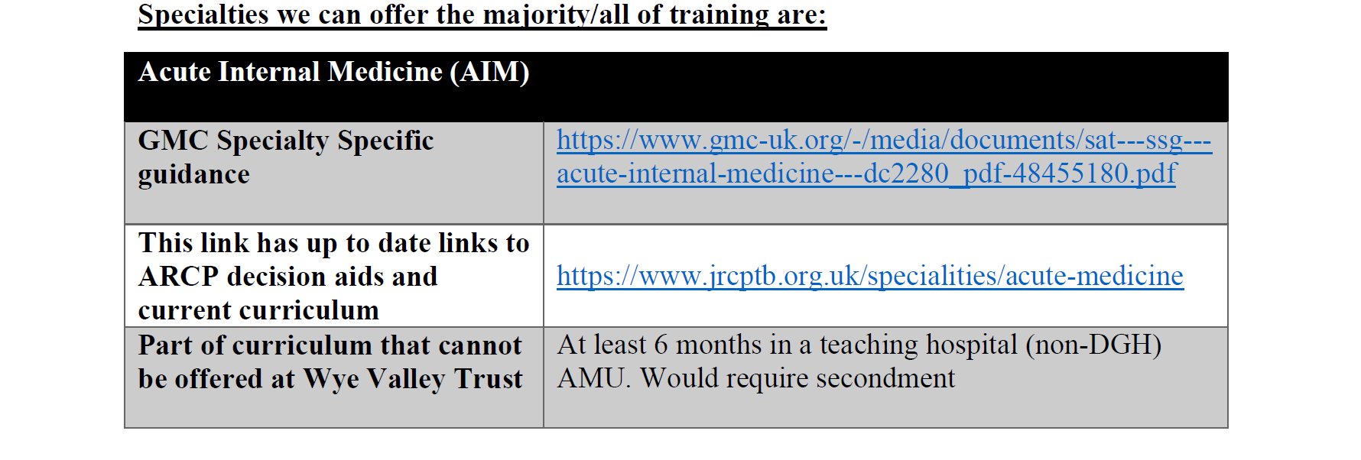
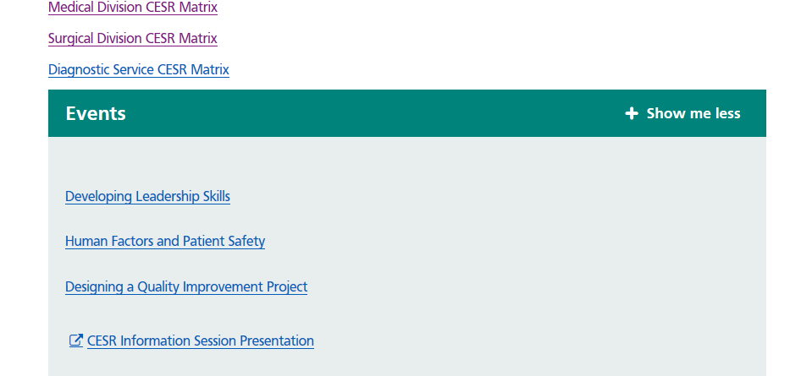
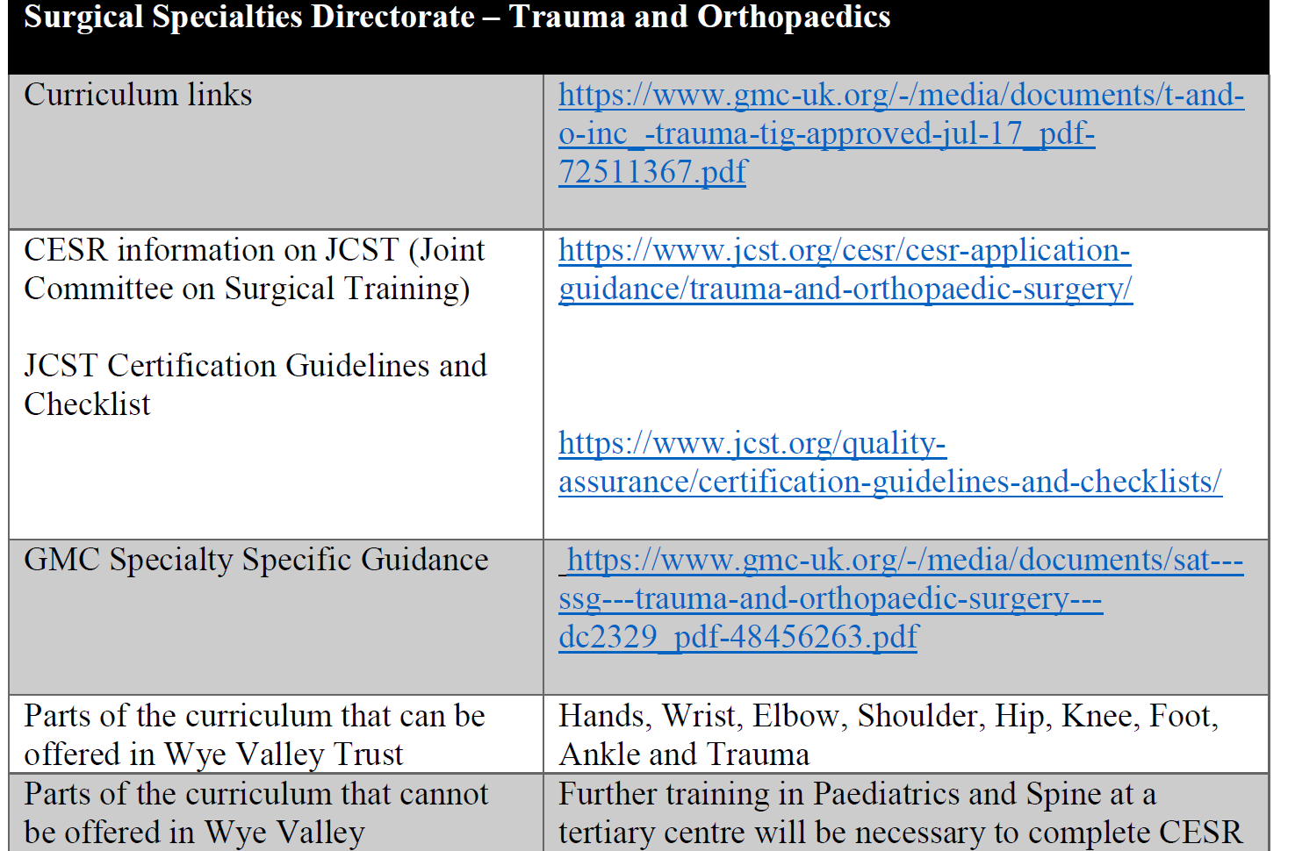

Slide 21
What is the new project?
A scoping exercise to explore whether CEGPR does offer a feasible alternative route for rural GP recruitment

Slide 22
What is CEGPR?
an alternative route to apply to the GP Register
Doctors in a non training post in the UK
Overseas doctors from some countries
  Streamlining application for doctors from Canada ,South Africa and Australia

Slide 23
Why is it needed?
Recent workforce survey across 83 practices across Herefordshire and Worcestershire
  1/3 of practices cite GP workforce as high risk
  Age of GP > 50 years
    Herefordshire highest , 64% vs 45% at Worcestershire
  Less full time equivalent GP lower than national average
  GP trainee numbers
    Leaving ≠ training
      Rural location
      Some benefit from TERS scheme , but most return to big city for substantive post

Slide 24
Why it could be attractive?
Experienced SAS/LED doctors with personal circumstances
Put off by the need to do night shift on traditional GP- VTS scheme
Dual registration of CESR and CEGPR could open more flexible working pattern
GMC findings
  Benefit from streamlining and simplification.
  Lack of awareness as alternative route of training pathway
Notes:
The GMC commissioned this research to investigate stakeholder perceptions of the Certificate of Eligibility for Specialist Registration (CESR) and the Certificate of Eligibility for the General Practice Register (CEGPR). It considers views on the robustness of processes leading to their award, their equivalence to the Certificate of Completion of Training (CCT) and the confidence they command among trainees, doctors, employers and assessors.
The findings are based on 1,422 completed surveys (response rate 14.7%) and 22 interviews with the following groups:
NHS employers (medical directors and HR directors)
Certificate holders (doctors on the GP and Specialist Registers)
Trainees (junior doctors in training)
Surveys of SAS doctors (staff grade and associate specialist doctors)
Senior representatives from the royal colleges and faculties
Key conclusions from the research
There are diverse views in the profession and wider NHS regarding the equivalence of routes to certification.
There is a perception among the profession that the CESR / CEGPR application would benefit from streamlining and simplification.
There is a lack of awareness regarding the CESR / CEGPR routes that inevitably leads to some misgivings regarding their robustness.

Slide 25
How its going to be done ?
Research the CEGPR
Arrange meetings with GP trainers
Arrange meetings with potential trainees to obtain their perspective on CEGPR, is it attractive to them?
  Organise focus groups
Summary paper on proposed CEGPR to GP stakeholders to get feedback and validate the summary paper with agreement from GP stakeholders
Notes:
, and answer the question, is it a deliverable attractive alternative to recruit GPs locally? Produce an initial report of the findings
via the Herefordshire and Worcestershire training hub to scope existing local capacity for CEGPR training
Invite GPVTS trainees, foundation doctors and open the forum to anyone potentially interested in a GP career even if they are in another specialty at present

Slide 26
What it can provide ?
Centre of excellence for providing CESR/CEGPR
Home grown local workforce to maintain sustainability of the workforce
Some parts already providing results in secondary care
Expand that vision to include primary care
Initially in Herefordshire with the intention to spread the learning and potentially upscaling across Worcestershire to cover the STP geography.
local solution to enhance our long term capacity to deliver safe services.

Slide 27
Who will be involved in CEGPR Project
Dr Jayne Clarke – Consultant Paediatrician with Special Interest in Respiratory Medicine and Associate Medical Director of Education ; Project Sponsor
Dr Gajendran Kanagalingam – Specialty Doctor in Obstetrics and Gynaecology ; Project Lead

Slide 28

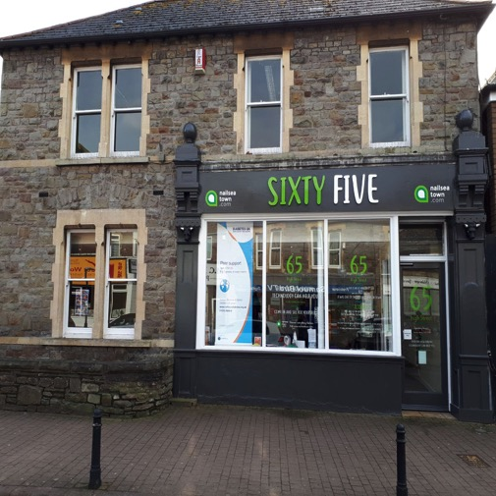
Ian Morrell: Development Manager@65 High Street
Nailsea, North Somerset BS48 1AW
ian@nailseatowncouncil.gov.uk
07934 291670
Notes:
This may not be a very good sales pitch, but actually our USP is not the digital service, it is having the place and the people to create the environment in which digital support can thrive.
In a public vote up against large councils logically we should not be here, but the fact we are suggests that a grass roots approach is valued by people, creating real affection and affinity for No 65, which has actually been demonstrated during this DL100 process.
And there is nothing unique about what we do. There are many places like 65 around the country, but most are operating hand to mouth and come up against innumerable bureaucratic obstacles which inhibits their potential and the opportunities to create more of them.

Slide 29
The Importance of a ‘Place’
No 65 users (examples)
2nd Step (mental health) cafe
6t5 Youth Club
Art and craft exhibitions
ASD support group
Better Nailsea/Nailsea in Bloom
Boom Satsuma
Cancer Café
Citizens’ Advice/NS Council
Dementia Meeting Centre?
Therapeutic art/craft groups
Wellspring Counselling
Workshops
Young Carers
Run by us
Hidden Histories
KiActiv@65
NHS Digital: Techno-Timid
Switching Service

Slide 30
Salutogenesis@65
Concept created in the 1970’s by Aaron Antonovsky
The principle is to focus on peoples’ resources and capacity to create health
not on the medical medical focus of risks, ill health, and disease.
Key Terms
Sense of Coherence
Learned Resourcefulness
Learned Hopefulness
Connectedness, Belonging, Resilience
Health, Stress and Coping
Problem Solving and Activation

Slide 31
Treat the Person not the Condition
‘no decision about me without me’
Wellbeing is made at homes and in communities, not in hospitals and clinics
Community organisations are resourceful, adaptable and cost effective
Community groups need places (not council one-stop shops) to meet, share, support – places connect people
Community not agency-led has unique advantages
Develop knowledge and confidence

Slide 32

People-Centred Health and Wellbeing
PEOPLE
Knowledge
Activation
Coping
Resilience
SOCIAL (wellbeing) MODEL
3rd Sector, Families/friends, Communities
MEDICAL
(illness) MODEL
Hospital, Clinic,
GPs, primary care
SMART TECHNOLOGY
Digital skills
Assistive Tools
Notes:
The potential for digital, especially assistive technology to help people is huge, but it is a tool, not an end in itself. The very nature of places like No 65 is that we have to be focussed on people rather than processes, because that is all we do!

Slide 33
Linking the Medical and Social Models
Statutory Bodies e.g NHS, District/County Councils, large charities
BARRIERS TO COLLABORATION
not done/invented here, silos, budgets, policies, professional boundaries, reorganisations, trust, power
SCALE
3rd Sector e.g. volunteers, local charities, Community Interest Companies (CICs), housing associations

Slide 34
What is the Return on ‘Investment’?
Buying and running high street premises does not come ‘cheap’
Charging for use covers some costs
Parish Councils make grants: groups using No 65 can be in lieu (or in addition to a grant)
The impact of Social Value i.e. the return on £1 spent
No 65 is an engine for generating social value – local authorities and NHS should be investing in ‘No 65s’

Slide 35

Our Ethos
We are custodians not owners
Human scale and relationships not economies of scale and structures
No labels and no silos
Trust people: listen and learn
Synergy happens one conversation at a time
Less Planning = More Serendipity
It’s easier to apologise than ask permission
Amazing things happen when no one wants to take the credit

