Slide 1

Rural Health and Social Care:
High Quality Care Close to Home
Professor Roger Strasser AM,
Professor of Rural Health
University of Waikato, New Zealand
Founding Dean Emeritus
Northern Ontario School of Medicine

Slide 2


Slide 3
Rural Health
Around the World
access is the rural health issue
resources concentrated in cities
communication
and transport difficulties
rural health workforce shortages

Slide 4
Rural Practitioners
“Extended Generalists”
wide range of services
high level of clinical responsibility
relative professional isolation
specific community health role

Slide 5
Rural Health Care Delivery
different from cities
local services preferred
not assume patients will travel
specialists’ support role
partnership not putdown
consultant support local service

Slide 6
Interprofessional Teamwork
Much talked about in the cities
Actually happens more
in rural communities
- workforce shortages
- community relationship
- responding to community needs

Slide 7
Recruitment Facilitators for Rural Practice
rural upbringing
positive undergraduate
rural clinical & educational experiences
targeted postgraduate training
for rural practice

Slide 8
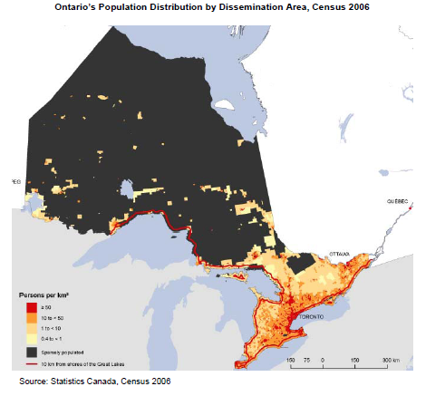

Slide 9
Northern Ontario School of Medicine
(NOSM)
Opened September 2005
Faculty of Medicine of Laurentian
Faculty of Medicine of Lakehead
Social Accountability mandate
Commitment to innovation

Slide 10
Distributed Community
Engaged Learning
widely distributed human and
instructional resources
over 90 different sites
independent of time and place
community partner locations
distributed across Northern Ontario

Slide 11
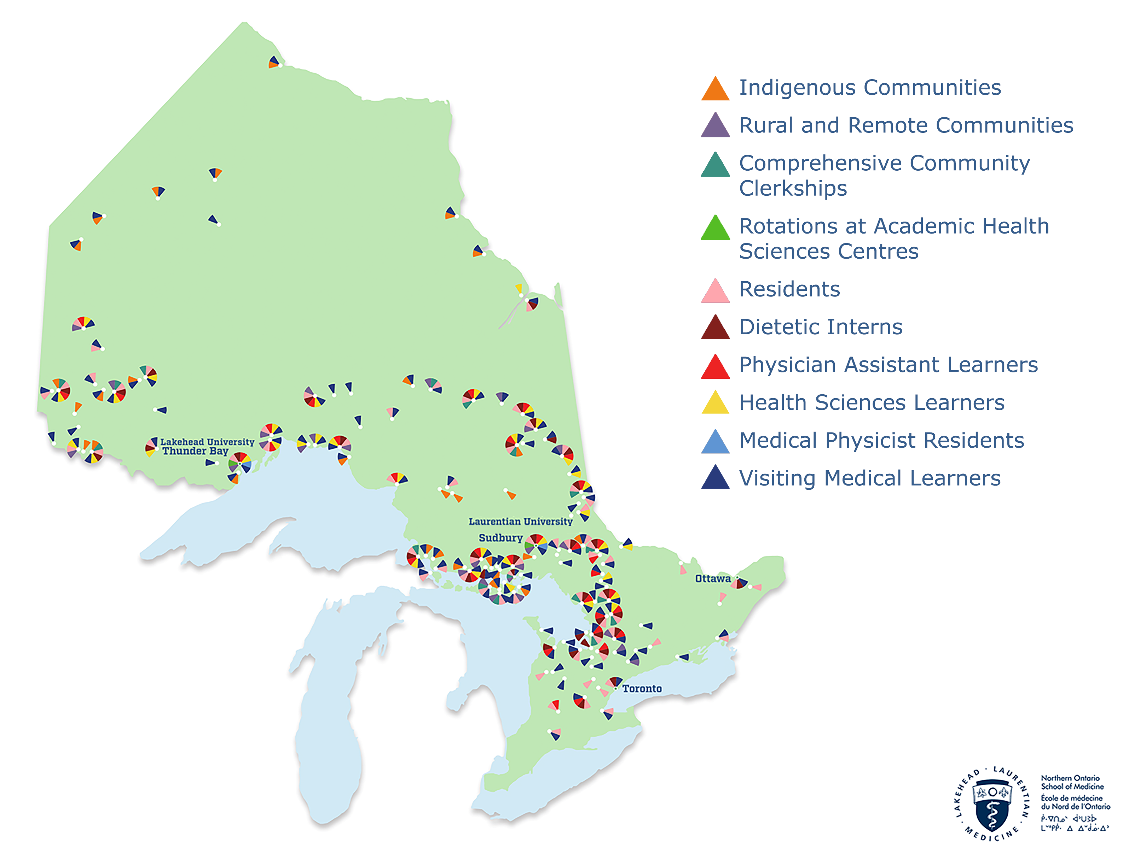


Slide 12
NOSM Admissions Summary
  >2,000 applications/year for 64 places
    20% of applicants interviewed
    15% of interviewees enrolled
  Class Profile
    92% Northern Ontario
    40% Remote and Rural
    7% Indigenous 22% Francophone
    GPA 3.7
    Age 26 (except 28 charter class)
    68% Female 32% Male

Slide 13
Student Experience of NOSM
rural medicine… that’s where
you find the true generalists*
I like how much variety there can be in
the doctor’s role**
we’re better off … we will (learn) more
skills in a rural centre**
you don’t know it until you live it**
* NOSM Tracking Study, Hoi Chiu ** PhD Research, Tim Dube

Slide 14
NOSM Career Directions
62% general practice, mostly rural
33% general specialties
5% sub-specialties
69% of NOSM residents stay in
N Ontario (22% remote rural)
94% NOSM MD plus residency in
N Ontario (33% remote rural)

Slide 15
Benefits of NOSM
More generalist doctors
Enhanced healthcare access
Responsiveness to Indigenous,
Francophone, rural, remote
Interprofessional cooperation
Health research
Broader academic developments
Economic development

Slide 16
Remote Rural Workforce Stability Framework

Slide 17
Underpinnings of the Framework
Taking the long view is essential
Strike a balance urgent vs long view
- inter-sectoral investment in training and career promotion
- create a desirable workplace
- transient workers to make a longer-term
commitment to your region

Slide 18
Plan
Assess Population Service Needs - specific health needs vary from community to community and over time
Align the Service Model with Population Needs - model designed in and for community, not imported from city
Develop a Profile of Target Recruits - identify required mix and skills of providers for the service model

Slide 19
Recruit
Emphasize Information Sharing - all about the professional, personal/family and social aspects of the work
Community Engagement - active community participation is essential to successful recruitment
Supporting Spouses / Families - the whole family has to feel welcome and at home in the community

Slide 20
Retain
Supporting Team Cohesion - friendly, supportive work environment with accessible specialist support
Relevant Professional Development - local team learning, on-line and funded travel to keep up-to-date
Training Future Professionals - learning in remote rural settings improves retention and provides future recruits

Slide 21
Conditions for Success
Recognition of unique rural and remote issues
Inclusion of remote rural engagement & perspectives
Targeted investment
An annual cycle of activities
Monitoring and evaluation

Slide 22
Social Accountability
“building accountability that relies on civic engagement, in which citizens participate directly or indirectly in demanding accountability from service providers and public officials”
World Bank, 2009
“Social Accountability of medical schools is the obligation to direct education, research and service activities towards addressing the priority health concerns of the community, region and/or nation they have a mandate to serve” WHO, 1995

Slide 23
Partnership Pentagram
Policy makers
People’s health needs
Health Managers
Health professionals
Communities
Academic institutions

Slide 24
Conclusion
Commonalities - remote rural communities have much in common even across international boundaries
Education and Training - training of local remote rural people, in remote rural locations, for remote rural jobs leads to successful recruitment and stability of remote rural services
Community Engagement - active community participation is essential to successful stable remote rural health services

Slide 25
References
Strasser R. Rural Health Around the World: Challenges and Solutions. Family Practice. 2003; 20: 457-463.
Strasser R. Learning in Context: Education for Remote Rural Health Care. Rural and Remote Health. 2016; 16: 4033.
Strasser R. Recruiting and retaining a rural medical workforce: the value of active community participation. (Guest Editorial) Med J Aust. 2017; 207: 154-158.
Strasser R, et al. Community engagement: A central feature of NOSM’s socially accountable distributed medical education. CMEJ 2018; 9(1): e33-e43
Strasser R, Mitchell D, Logozzo J, Preston P, Walker N. Challenges of Capacity and Development for Health System Sustainability. Healthcare Papers 2018, 17(3): 18-27.
Abelsen B, Strasser R, et al. Plan, Recruit, Retain: A Framework for Remote Rural Workforce Stability. Human Resources for Health. 2020; 18: 63.

